Slide 1
Academic Advising Session For Newly Admitted Students
Computer Science & Software Engineering (CSSE):

Slide 2
Computer Science & Software Engineering (CSSE):
Chair of the Department: Dr. Paquet joey.paquet@concordia.ca
Program directors:
Bachelor of Computer Science: Dr. Wang ugpd-compsci@concordia.ca
Software Engineering: Dr. Rigby peter.rigby@concordia.ca
Program assistants: Natallia Lapko and Carly Carruthers

Slide 3
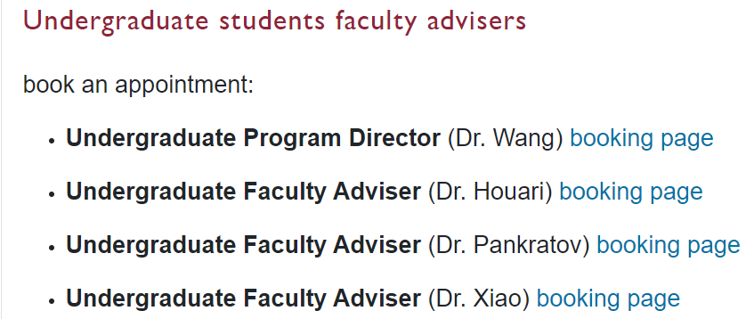
How to contact us:
* Program assistants cse-ugrad@concordia.ca
Mondays: on-line advising 10am – 12pm https://concordia-ca.zoom.us/j/82586078275 Meeting ID: 825 8607 8275
Tuesdays: in-person advising - ER Building 10th floor - 2pm – 4pm
Wednesdays: in-person advising - ER Building 10th floor - 2pm – 4pm
Thursdays: online advising 2pm – 4pm https://concordia-ca.zoom.us/j/82586078275 Meeting ID: 825 8607 8275
Faculty members: book an appointment https://app.acuityscheduling.com/schedule/c263e6e7

Slide 4
Program Requirements:
Bachelor of Engineering, Software Engineering
Bachelor of Computer Science
Bachelor of Computer Science Joint Major in Data Science
Bachelor of Computer Science Joint Major in Computation Arts and Computer Science
Bachelor of Computer Science in Health and Life Sciences
Minor in Computer Science
Extended Credit Program (BCompSc, including Joint Majors)
Extended Credit Program (BCompSc Health and Life Sciences)
Extended Credit Program (SOEN)

Slide 5
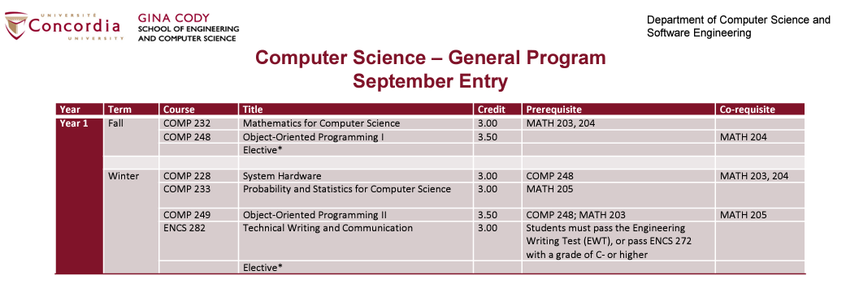
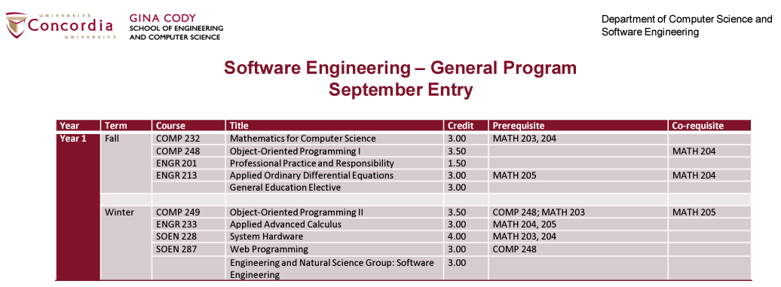
Useful Resources: How can I know what courses to take?
Course sequences

Slide 6
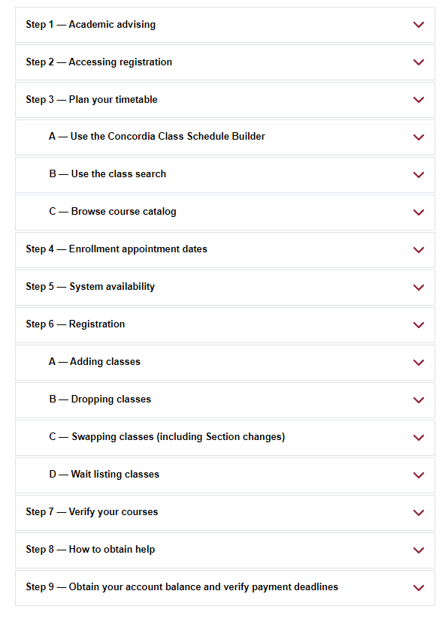
Useful Resources: How to register for a course?
Course registration guide

Slide 7
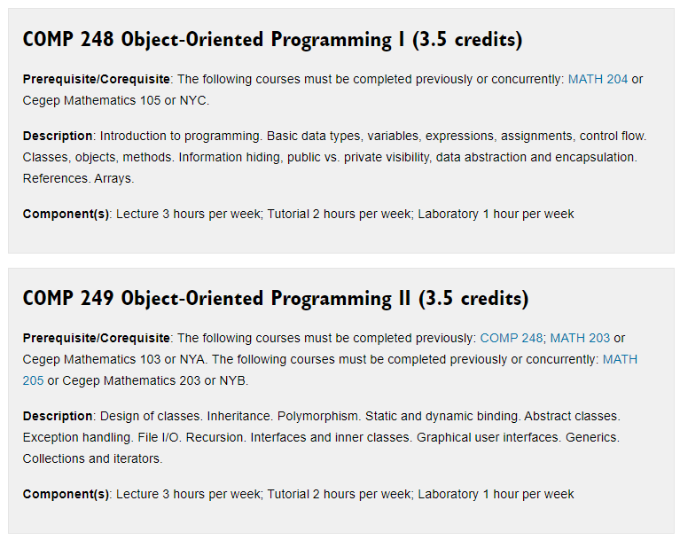
Useful Resources: What the course is about?
Course Descriptions

Slide 8
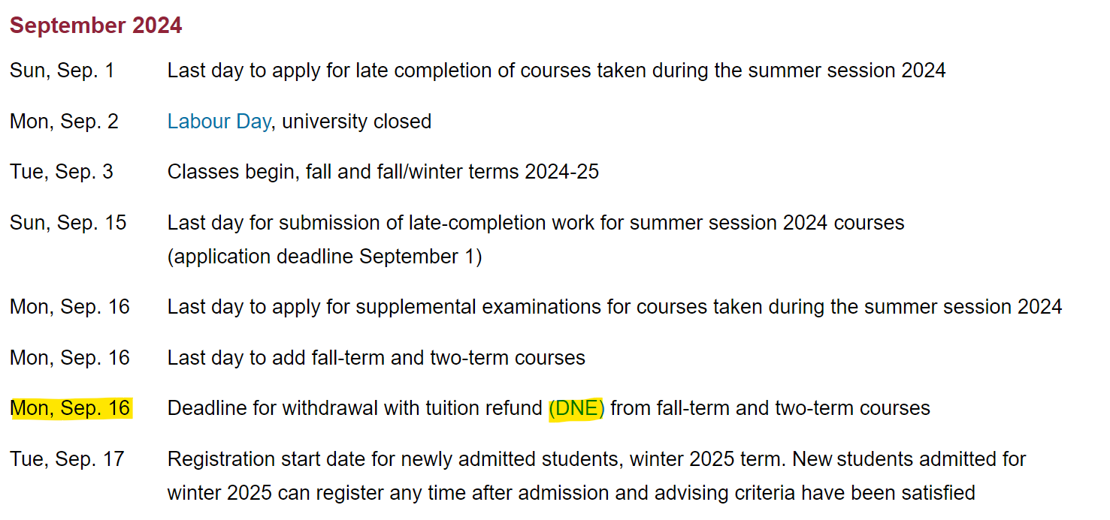
Useful Resources: To know WHEN
Important Academic Dates

Slide 9
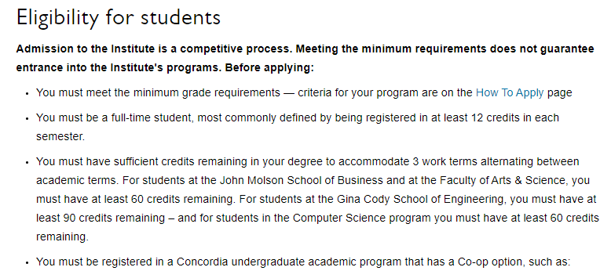
Useful Resources: Coop
Institute for Co-operative Education
COOP Director Dr. Jayakumar: jayakumar@cse.concordia.ca
General inquiries: info.coop@concordia.ca

Slide 10
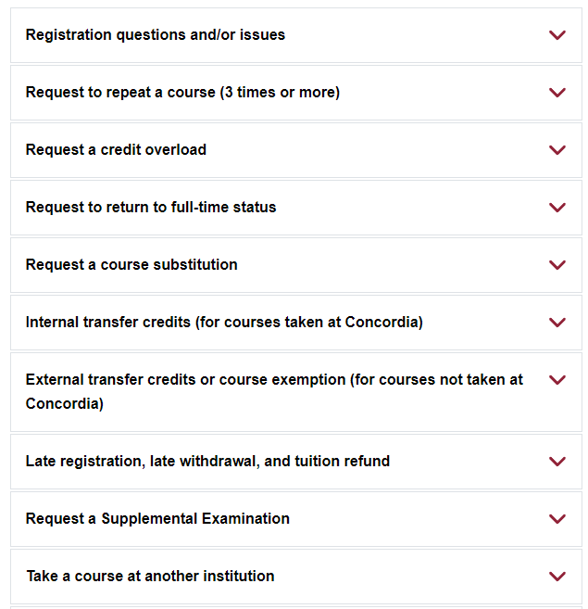
Useful Resources: SAS
Student Academic Services Office (SAS)
General inquiries: sas-front-desk@encs.concordia.ca
Student requests and forms: https://www.concordia.ca/ginacody/students/academic-services/undergraduate/requests.html

Slide 11
Student services:
Student Hub
Birks Student Centre
Student Academic Services – Gina Cody School
Academics & Library resources
Co-op & Student Exchange
Student Associations & Clubs
Financial services & funding
IT support & software
Sports, fitness & recreation
Safety & security
Housing & food

Slide 12
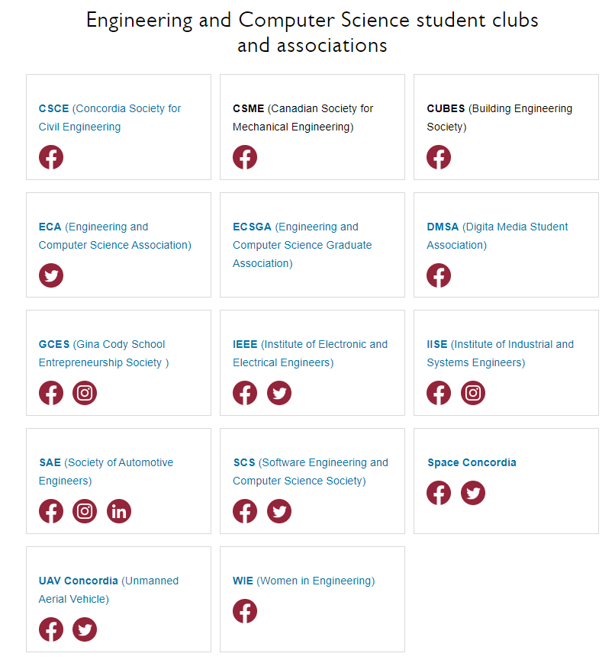
Useful Resources: Student Clubs and Associations
Student Associations

Slide 13
Useful Resources:
Undergraduate Calendar
Department of Computer Science and Software Engineering (CSSE)

