Slide 1
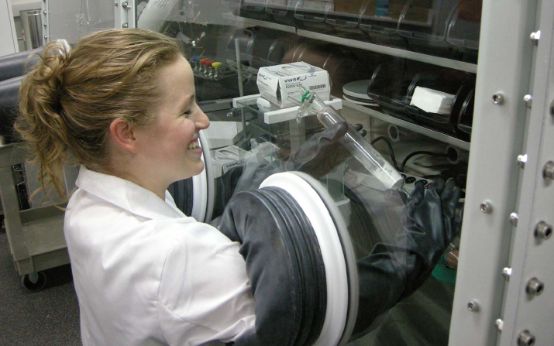
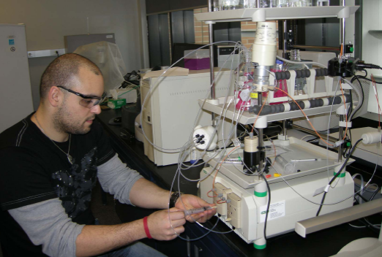
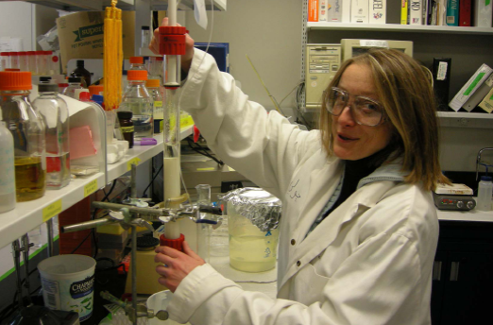
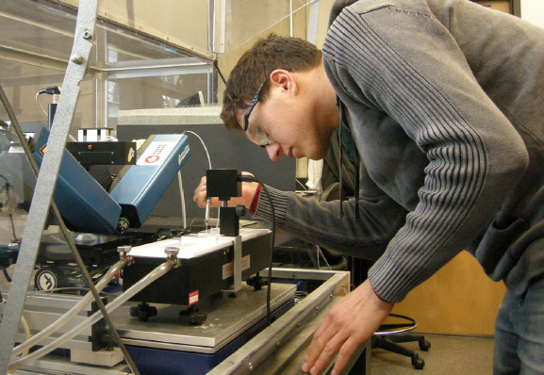
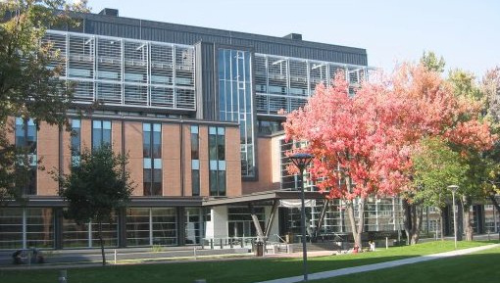
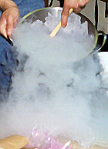
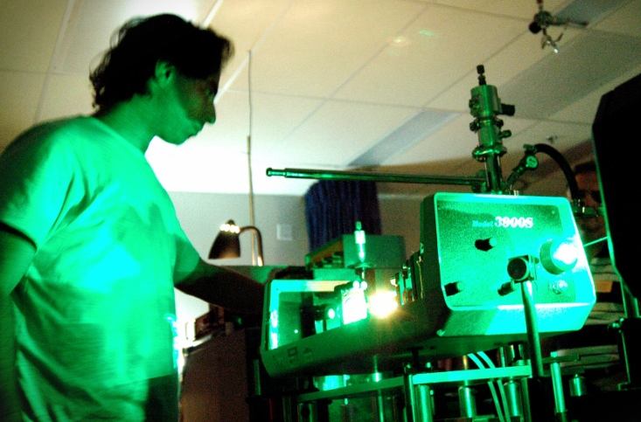
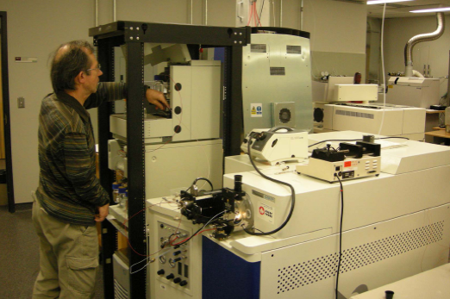
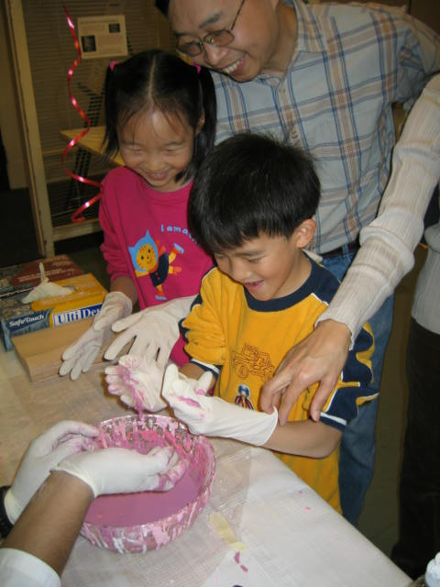
Chemistry and Biochemistry FAS Touchstone
S2024
(15 Apr 2024)

Slide 2
A Two-part Presentation
CHEM Touchstone presentation
Information available on the departmental advising page at https://www.concordia.ca/artsci/chemistry/programs/undergraduate/procedures-forms.html
Make sure that you are familiar with your program and your degree. Ask your questions early!
The FAS Touchstone seminar introduces you to the resources available to help you navigate the university

Slide 3
Department Contacts
Questions about courses and your program?
Contact the departmental undergraduate student advising team —
Departmental advising hub https://www.concordia.ca/artsci/chemistry/programs/undergraduate/procedures-forms.html
Dr. Gregor Kos, Undergraduate Program Advisor (chembiochem.advising@concordia.ca)
Dr. Xavier Ottenwaelder, Co-op Academic Director (dr.x@concordia.ca)
Lisa Montesano, Undergraduate Program Assistant (chemistry.reception@concordia.ca)
Advising hours: See automatic booking link for availabilities; if you are unavailable, please send an email with 3 slots that you are available (date & time)
Include your student ID in all requests
Dr. Heidi Muchall, Undergraduate Program Director
Maria Dochia, Technical Staff Supervisor
Department faculty (transfer credit review)

Slide 4
Programs Offered
Honours (Chemistry or Biochemistry)*
Specialization (Chemistry or Biochemistry)*
Major (Chemistry or Biochemistry)
NEW: Environmental and Sustainability Science, ESS (Honours & Specialization)
(Minor (Chemistry))
* Accredited by the Ordre des chimistes du Québec (OCQ)
Science College (Patricia Paul, admin.scol@concordia.ca)
Co-op (Xavier Ottenwaelder, dr.x@concordia.ca)

Slide 5
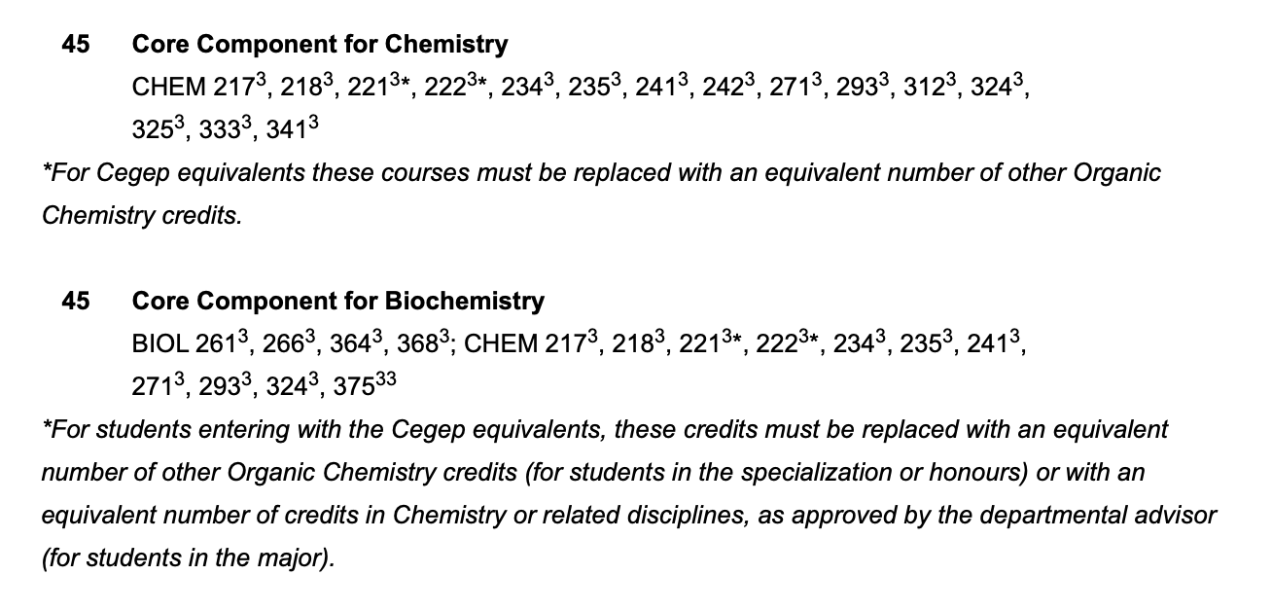
Reading the UG Calendar
number of credits
course numbers
CHEM XYZ
X: level (200, 300, 400)
Y: discipline (1= analytical, 2= organic, 3=physical, 4=inorganic, 5=interdisciplinary, 7= biochemistry, 9=spectroscopy);
Z: sequence number
special notes;
e.g, organic replacement

Slide 6
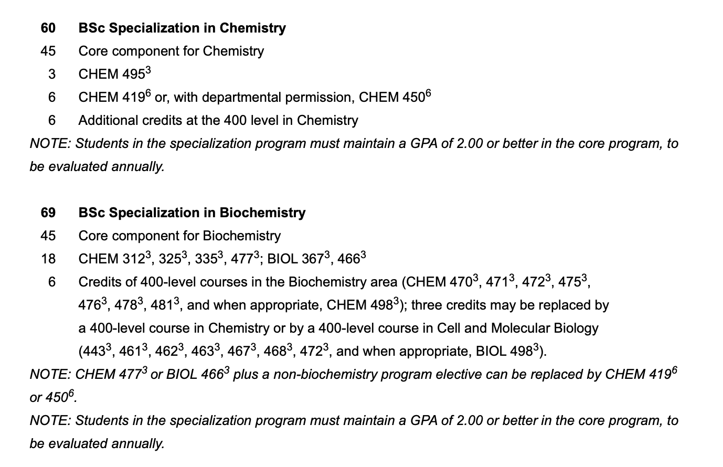
Reading the UG calendar: Programs
required program credits
remaining credits are electives

Slide 7
Electives
How many do I need?
Required credits for degree – required credits for program
120 cr: 30 sci. profile + 45 core program + 24 cr ext. core = 21 cr (Spec, Biochem)
90 cr: 45 program = 45 cr (Maj Biochem)
What can I take?
24 credit rule:
6 cr MUST be out of sector (i.e., not science courses)
18 cr* MUST be out of discipline (i.e., not chemistry/ biochemistry courses or required biology courses)
Remaining electives can be any course (chemistry, biochemistry, science or non-science)
* In a 90 credit Specialization or Honours biochemistry program, this reduces to 15 and 12 credits respectively.

Slide 8
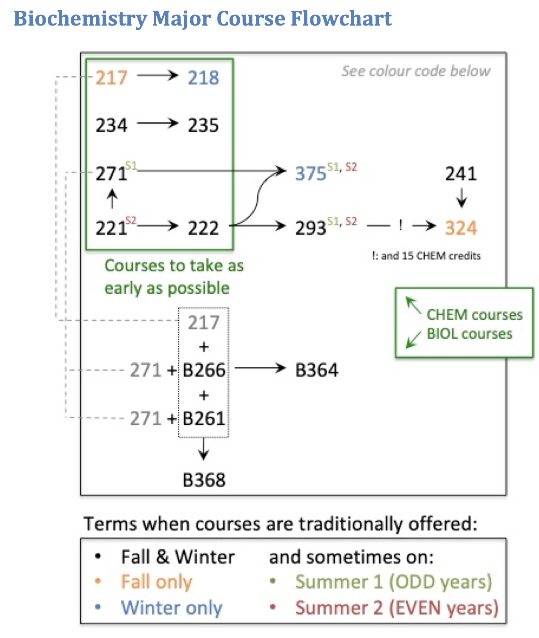
Reading the UG Calendar: Courses
Course sequence and planning for registration
https://www.concordia.ca/artsci/chemistry/programs/undergraduate/procedures-forms.html

Slide 9
Read the Class Schedule
Course
instructor
Lab & tutorial alternating
Room & campus
Term

Slide 10
Important Dates and Deadlines
Changing your courses
DNE: Last day to add/remove courses without academic or financial penalty
DISC: Last day for academic withdrawal (with/without refund)
Labs & Tutorials
Generally, labs start the second week of term (i.e., first full week of term)
Always check your course outline for changes!
Mandatory CHEM 101 seminar
Academic code of conduct, usually 3rd week of term (see course outline for changes)
Final Exams
Schedule available late October/early November (for Fall term)
https://www.concordia.ca/events/academic-dates.html

Slide 11
Register for Courses! ASAP!
Register as soon as possible for all your courses once your registration block is lifted (during the next 2 working days).
If a course is full you will need to keep trying. For courses with labs, access to a lab section (e.g., CHEM 205, CHEM 217) is required to get into the course.
Once you are registered for a space in the lab, access to the lecture is automatic. Check different lab sections for free spaces.
Students will drop in the meantime as they adjust their schedules. A seat might become available anytime on a first-come-first-served basis. Keep checking back often.
If one or more courses are full, register for other courses with spaces available, while you keep trying for the others.

Slide 12
If you change your mind…
And you would like to change sections (e.g., to a different lecture or lab section or both)
Use the SWAP function to switch
Never DROP the course to re-enrol in a different section; the space might be taken by another student waiting to enrol
Any inadvertent drops cannot be undone. The drop is final
If you need help with swapping, please contact Lisa Montesano at chemistry.reception@concordia.ca.

Slide 13
Labs
You will need:
lab coat
safety glasses
lab book
Remember:
Name & contact details of the teaching assistant (TA)
Completed pre-labs are required to enter the laboratory
Late entry into labs is not permitted
Data sheet must be signed by TA
Your lab supervisor will provide detailed information at the mandatory introductory session.

Slide 14
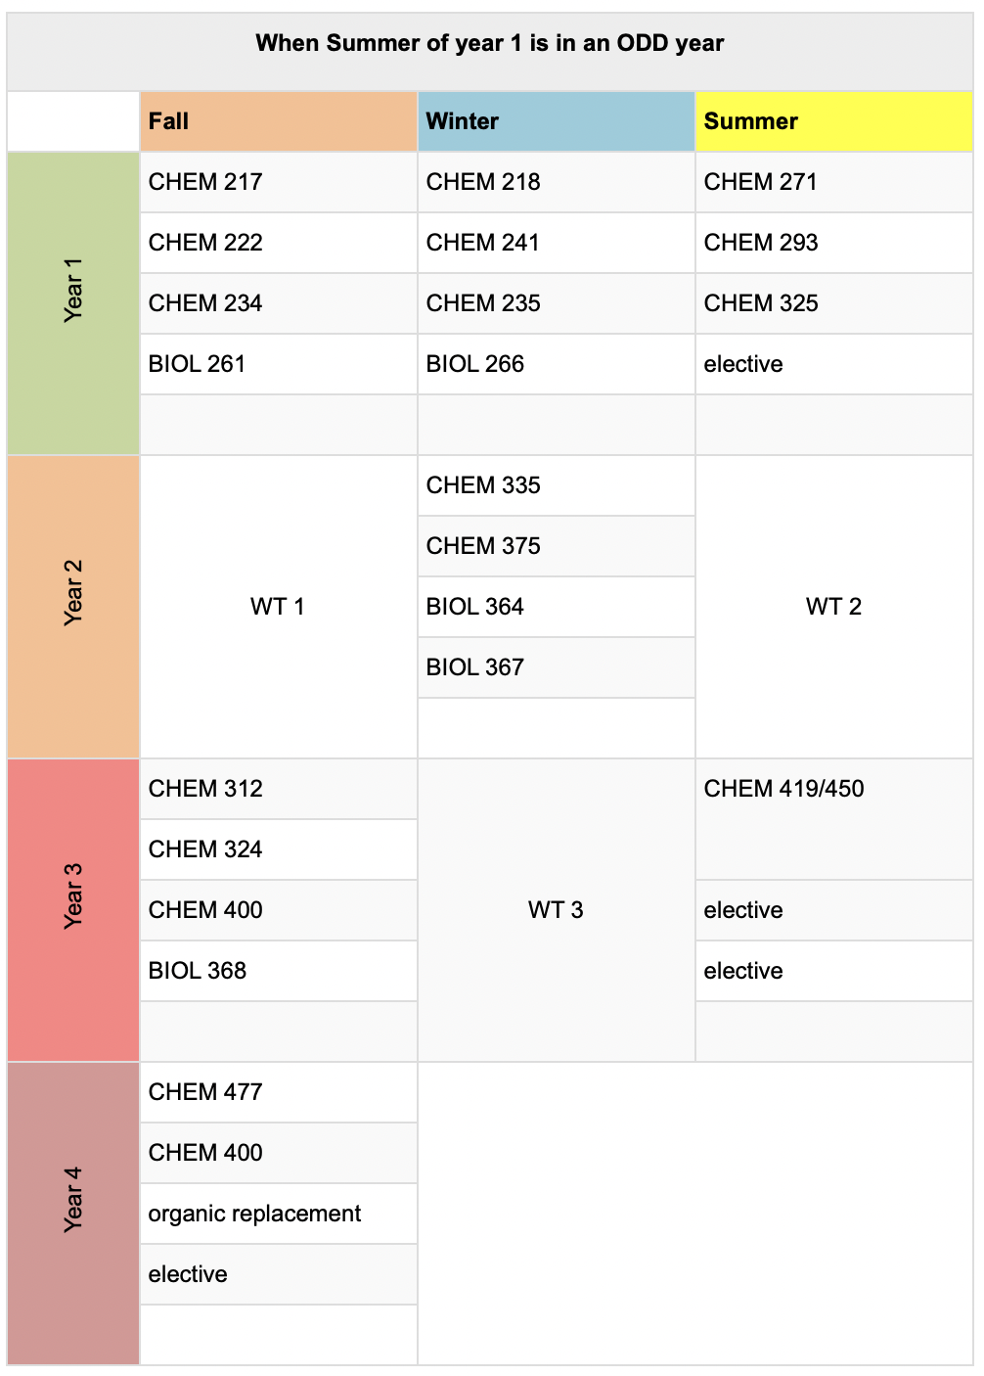
Co-op and C.Edge Options
Add PAID WORK EXPERIENCE in your field whilst studying
Co-op = 3 internships
Requirements:
Specialization or Honours
Full-time status (12 credits each study term)
Min 2.8 GPA
C.Edge = 1 internship
Specialization or Honours
Min 2.5 GPA
+2 electives
In-takes: Co-op: Admission, and every January and September
C.Edge: every February
dr.x@concordia.ca

Slide 15
Key Sources of Information
Student Portal on myConcordia: https://my.concordia.ca/
incl. Academic Requirements/Advisement Report to monitor your study progress
Chemistry & Biochemistry website: http://chem.concordia.ca/
Chemistry & Biochemistry Information: https://www.concordia.ca/artsci/chemistry/programs/undergraduate/procedures-forms.html
Chemistry & Biochemistry Undergraduate Calendar: https://www.concordia.ca/academics/undergraduate/calendar/current/sec31/31-050.html
Academic Dates: https://www.concordia.ca/events/academic-dates.html
Birks Student Center: https://www.concordia.ca/students/birks.html
Student Academic Services: https://www.concordia.ca/artsci/students/sas.html
International Students Office: https://www.concordia.ca/students/international.html
Departmental Advisors: https://www.concordia.ca/artsci/students/department-advisors.html
Course registration guide: https://www.concordia.ca/students/registration.html
Elective groups: https://www.concordia.ca/artsci/academics/interdisciplinary/elective-groups.html
Late registration & withdrawal: https://www.concordia.ca/content/dam/concordia/offices/registrar/docs/forms/student-request.pdf
Google search the Concordia website: Type your search term with “Concordia” included

Slide 16
HELP!
Professor of your course!
Departmental academic advisor
chembiochem.advising@concordia.ca
chemistry.reception@concordia.ca
Student Hub (http://www.concordia.ca/students)
Access Centre for Students with Disabilities (http://www.concordia.ca/students/accessibility)
Student Success Centre (http://www.concordia.ca/students/success)
Counselling (http://www.concordia.ca/students/counselling-life-skills)
Concordia Library Citation & Style Guides (https://library.concordia.ca/help/citing)
Health Services (http://www.concordia.ca/students/health)
Financial Aid and Awards (http://www.concordia.ca/offices/faao)
Academic Integrity (http://www.concordia.ca/students/academic-integrity)
Dean of Students Office (http://www.concordia.ca/offices/dean-students)
International Students Office (http://www.concordia.ca/students/international)
Sexual Assault Resource Centre (http://www.concordia.ca/students/sexual-assault)
HOJO, Off Campus Housing & Job Bank (https://www.csu.qc.ca/services/hojo)
CSU Advocacy Centre (https://www.csu.qc.ca/services/advocacy/)
Aboriginal Student Resources (http://www.concordia.ca/students/aboriginal)
Mental Health (https://www.concordia.ca/students/health/mental-health.html)

Slide 17
Opportunities
Keep an eye out and think ahead —
NSERC & Concordia USRA (departmental information session)
Summer research in the labs
International exchanges
Demonstrating and stock-room work
Strategic learning leaders
Scholarships and awards

