Slide 1
FAS Touchstone Advising for newly admitted students
Presented by Student Academic Services (SAS)
https://www.concordia.ca/artsci/students/sas.html
514-848-2424 ext. 2104
sas.fas@concordia.ca
LOY-AD-202

Slide 2
Agenda: Learn about your offer of admission Learn about the structure of our degrees Learn about your degree requirements and electives Learn about our academic advising structure Learn about the resources available to you Learn about the Student Center Gain invaluable registration tips and learn about next steps

Slide 3
Student Academic Services: Faculty-level advisors available to all faculty and university-wide students
What do we do?
We support students from across the faculty
We offer advising appointments (phone, zoom and in person)
Change of program
Concerns about academic standing
And many other things!
We support department advisors
We oversee the Student Request process
To reach us, you can call (514) 848-2424 ext. 2104, email sas.fas@concordia.ca

Slide 4
Understanding your Offer of Admission
Degree (BA, BSc, BEd)/Certificate
Program of study (Human Relations, Physics)
Concentration (Specialization, Major, Minor)
Minimum number of credits to earn degree (90, 108 or 120)/minimum number of credits to earn Certificate (30 credits)
Exemptions (EX) – are an acknowledgment of equivalent courses taken elsewhere – usually introductory level - cannot be taken for credit (indicated in offer of admission and on student record)

Slide 5
Transfer credits:
University transfer (you are coming from another post-secondary school)
You may have transfer credits
Specified by discipline (MATH) or general (GENL)
Are these courses applicable to your program? If so, use the Admission Transfer credit page for information on how to proceed
Not all transfer credits need to be specified (okay to keep as GENL)
French Baccalaureate (FB) and International Baccalaureate (IB)
You may have transfer credits – no changes can be made – they stay as they are!
Incomplete DEC:
You may have credits transferred as GENL – no changes can be made – they stay as they are!
Finalizing TRCs should be completed as soon as possible
Use the available course descriptions in the Undergraduate Calendar

Slide 6
Deficiencies – Bachelor of Science: ECP/MEP Science profile courses Language course (ESL 202, 204)
ECP – Extended Credit Program (120 credits)
BIOL 201
CHEM 205 & 206
MATH 203 & 205 (203 requires 201)
PHYS 204, 205, 206, 224, 225 & 226
MEP – Mature Entry Program (108 credits)
CHEM 205 & 206
MATH 202, 203 & 205
PHYS 204, 205, 224, & 225
Specific programs have additional course requirements
Biology & Psychology: BIOL 201, PHYS 206 & 226
Chemistry, Geography, Health, Kinesiology and Applied Physiology: BIOL 201, PHYS 206 & 226 (Environment Science add: MATH 204)
Math & Physics: MATH 204, PHYS 206 & 226

Slide 7
Degree structure: 90, 108 (MEP) or 120 credits (ECP) Transfer credits will count towards these minimums – could be towards program of study or electives! Certificate structure: 30
Programs of study and their concentration(s): Specialization (60-66 credits), Major (36-45 credits), Minor (24-30 credits)? Concentrations are made up of courses from the 200-, 300- and 400-level in your program of study).
Electives? Number of credits will vary depending on concentration of program of study (courses can be taken from various levels if you have the prerequisites). In the case of ECP/MEP students, some of your electives may/will be degree or program profile courses.
Certificates: some Certificates have specific courses you need to take while others have more flexibility

Slide 8
Faculty Structure: 27 Departments, Schools and Colleges Our departments are divided under different sectors: Humanities, Social Sciences and Sciences
Humanities:
Classics, Modern Languages and Linguistics Communication Studies
English Études françaises History Irish Studies Journalism Liberal Arts Philosophy Theological Studies
Social Science:
Applied Human Sciences Economics Education
Geography, Planning and Environment Political Science Religions and Cultures School of Community and Public Affairs Simone de Beauvoir
Institute Sociology and Anthropology
Sciences:
Biology Chemistry and Biochemistry Health, Kinesiology and Applied
Physiology Mathematics and Statistics Physics Psychology
Sciences:
Biology Chemistry and Biochemistry Health, Kinesiology and Applied Physiology
Mathematics and Statistics Physics Psychology
Science College

Slide 9
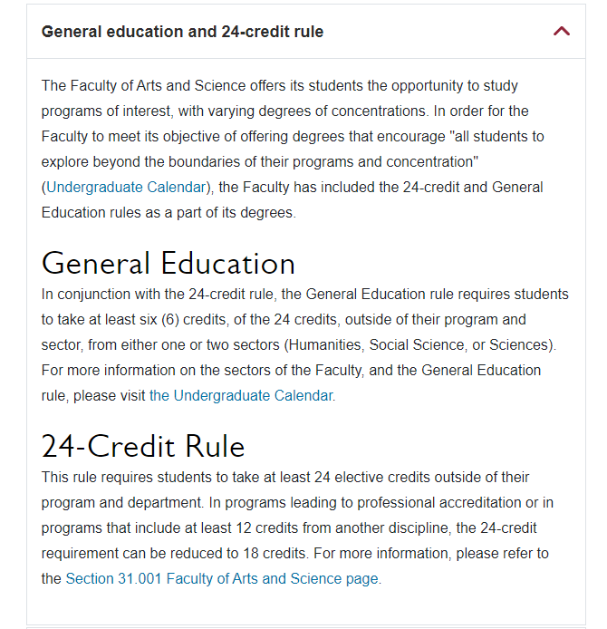
Degree Requirements: General Education (Gen Ed) and the 24-credit rule
Faculty broken down into three sectors: Humanities, Social Science and Sciences – impacts General Education requirement
Gen. ed. can also be satisfied with courses from another Faculty (Fine Arts, JMSB, GSC)
All courses have a four-letter designation (e.g., INTE) – important for 24 credit rule

Slide 10
Choosing your elective courses
Keep in mind 24 credit rule
01
Keep in mind General Education requirement
02
Use the list of courses open to all students to help you find courses
03
Consider Elective Groups
04

Slide 11
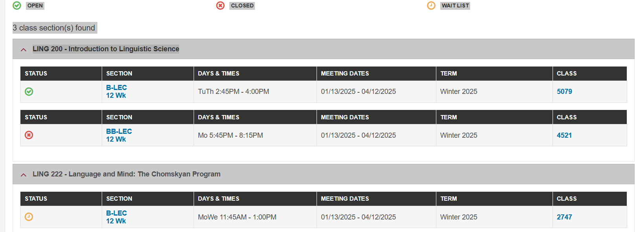
Class Schedule: Information on registration https://www.concordia.ca/content/dam/concordia/docs/your-sis/SIS-Helping-You-Register-for-Classes.pdf
This is the first page you see in the Class schedule – limited information

Slide 12
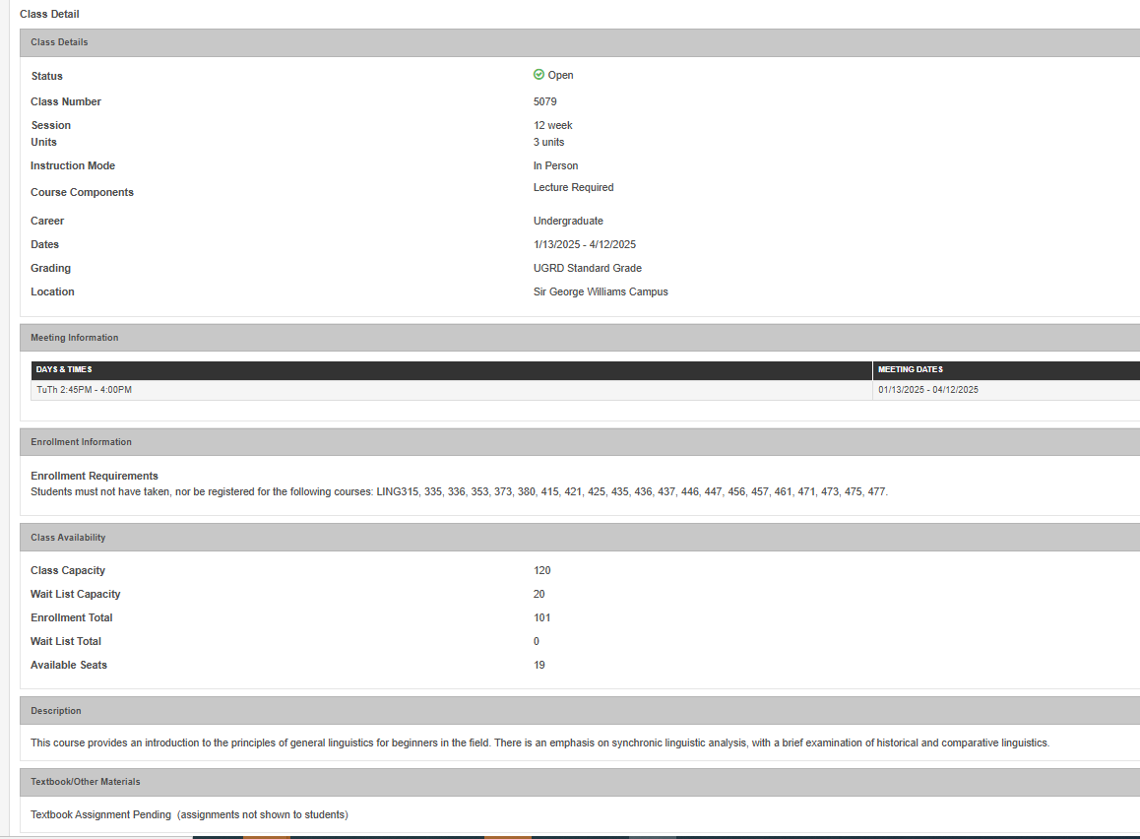

Slide 13
Your connection with your department advising team
Attend
Your department’s orientation sessions
Meet
Your department’s advising team
Ask About
Your course requirements and any curriculum
Review
Your program and degree requirements
Talk About
Exemptions, transfer credits, and other
based questions you have, registration
concerns, tutoring, special department events
university services
Learn more about academic advising and how it can support you as a student by going to the Academic Advising page in your Student Hub!

Slide 14
Resources for new students:
Welcome Guide for New Undergraduate Students
Newly admitted students (Phase 2)
Undergraduate Advising Guide
Faculty specific
Terms and definitions
Rules and regulations
New student services
Welcome Crew: course registration information sessions, New Student Orientation, First-year events
Homeroom
Student Hub
Everything you need to be a successful student!
Academic resources: https://www.concordia.ca/students/services/academic.html
Services and Resources: https://www.concordia.ca/students/services.html
Know your rights - Advocacy
IITS – get an email account: https://www.concordia.ca/it/services/office-365-education.html

Slide 15
The Student Centre

Slide 17
Registration tips:
Make sure you know what courses you need to meet program requirements
Many programs have course sequencing – meet with your department advisor to know the sequence!
Some courses are reserved for specific program students;– can make choosing electives challenging
If you have exemptions/transfer credits – you cannot repeat them
New class schedule available first week of March – know your registration dates and deadline
Your registration date posted in your Student Centre, in February, in your Enrollment box.
Register on time!!!!
Look for open electives – most students will need these! This list has courses with no prerequisites and are open to all students!

Slide 18
Registration tips:
Take program courses and electives – mix it up!
Do you need to repeat any courses? Use the repetition rule, if you need it!
Use the academic tools at your disposal: INC, DEF, MED (refer to Undergraduate Calendar – Section 16)
When you register, register for the full academic year (summer, fall and winter)
Put your name on waitlists, if necessary, but understand what that means!
Consider number of courses/credits per term? Do you work? Do you have other responsibilities?
Review grades at the end of the term –understand any administrative notation attached to your grades (Undergraduate Calendar – Section 16 )
Always confirm your schedule after you register!
Should you be full-time (4-5 classes/term – 12-15 credits)?
Know how and when to withdraw from courses should you need to do so!
Go to the “How to Guides” (bottom of page) to learn how to add your name to the wait list or create a swap

Slide 19
After registration, things to think about!
How will I make sure I am academically successful?
Go to class – participate!
Go to professor student office hours
Connect with other students in your classes
Where can I go for help?
See your department advisor
See an SAS advisor
Student Success Center
Study Skill workshops
Writing Assistants
Learning Specialists
Student Service Station
How will I know if I am succeeding academically?
Learn about your GPA and how to calculate it
Assessment – happens at the end of May
You'll be contacted if things don’t go well….

Slide 20
Pro-TIPS
Meet
Meet with your professor regularly! Meet with your advisor at least once a year! You can find their contact information!
Log
Log into your Student Hub/Student Centre weekly for notices/Download the FREE Office 365 from the Concordia Website – you’ll get a Concordia email address
Access
Access Centre for Students with Disabilities office
Use
Use the academic tools at your disposal: INC (can’t complete course work during the term, talk to your professor); DEF (you’re sick and can’t take your final exam, have an unexpected event take place)
Seek
Seek out University Services that you need to succeed! Student Success Center, Health Services, Counselling and Psychological Services….
Include
ALWAYS include your program of study, student ID# (available in your offer of admission) and full name with ALL university communication
Consent
In new student activities: Prepare, Connect, Start and Explore
Participate
Consent to release information to a 3rd Party

Slide 21
Have questions for me?:
Email me at: Shoshana.Kalfon@concordia.ca

