Slide 1

Community Economic Development Library Orientation
Michelle Lake
Subject Librarian for The School of of Community and Public Affairs, First Peoples Studies, Poli Sci and Government information
Michelle.Lake@Concordia

Slide 2

Your Subject Librarian
Who am I?
Michelle Lake, librarian for Political Science, the School of Community and Public Affairs, First Peoples Studies and Government Publications
Michelle.Lake@Concordia.ca / Book a one-on-one Zoom consultation or an in-person appointment
What do I do?
  Provide research support
  Teach and assist with library databases and search strategies
  Help you find and access materials, including scholarly materials, Indigenous scholarship, government documents, grey literature, etc.
  Build online guides, resources and pathfinders to help students locate research materials
  Help with citation issues
  Choose the books we buy for my subject areas: First Peoples studies, political science, public policy, community and public affairs and government information

Slide 3
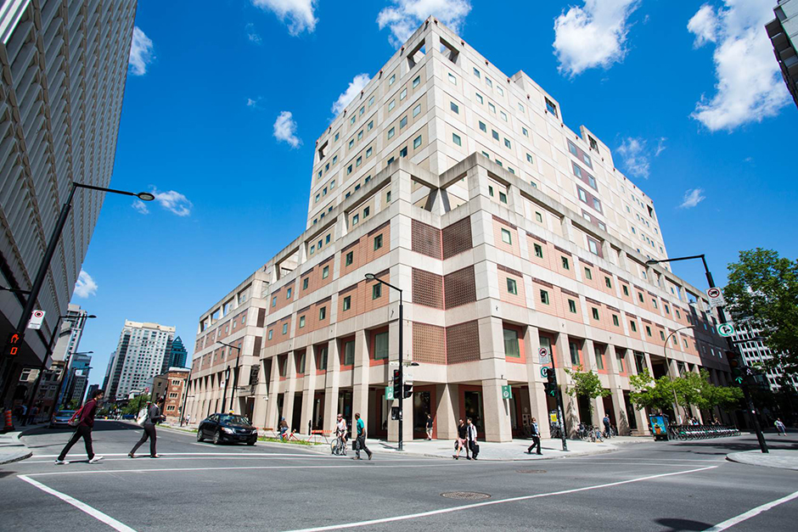
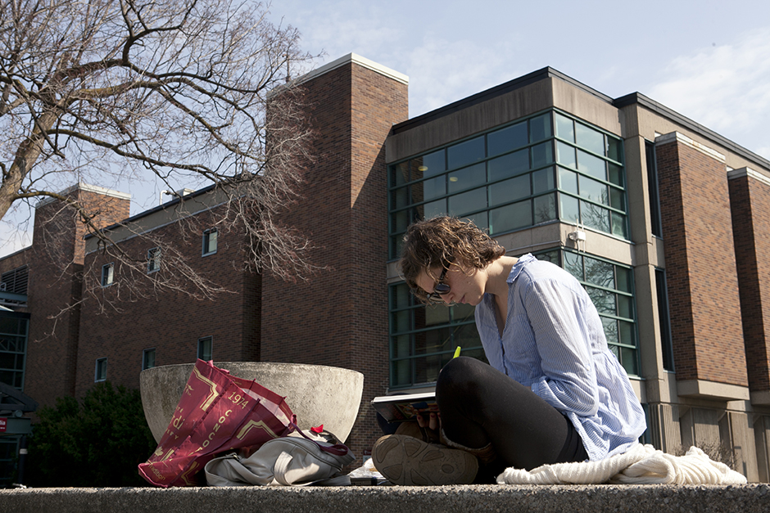
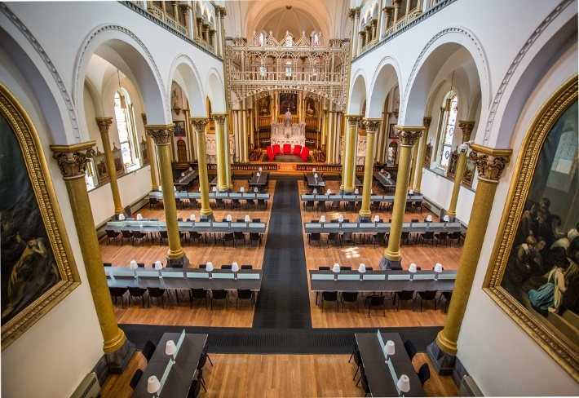
Webster Library (LB) – SGW Campus
24/7 access - between 11pm – 7am access with your student card
2nd, 3rd, 4th, and 5th floor of LB - “Library Building”
Poli Sci, Government Info, Maps, History, Social Sciences, Humanities, Engineering & Fine Arts
Interlibrary Loans
Current Print Journals
Dissertation Writer’s Rooms – LB5
Vanier Library (VL) – Loyola Campus
24/7 access - between 11pm – 7am access with your student card
1st, 2nd, and 3rd floor VL – “Vanier Library”
Sciences, Psychology, Communications & Journalism
Special Collections
Print Journal Archive
Graduate Study Carrels
Grey Nuns (GN) – SGW Campus
(1190 Guy St.)
Mon-Thurs 9am-9pm, Fri 9-5pm, Sat & Sun 10am-5pm
Access with student card
Group Study Rooms
Quiet Study
Bring your own device
Outlets/Wifi
No collections

Slide 4

Library Services
Your student card is your library card.
You need it to:
borrow books (up to 100 a time)
borrow a laptop (for 3 days) and other technology like tablets, chargers, headphones and cameras
print on campus (add money to your Dprint account)
access the library overnight during 24/7 hours.
Webster library has 5 book scanners (And Vanier has 2!) that can be used for free to scan chapters from our print books and email them to yourself as a PDF.
To use Library databases, access online articles and ebooks when you are off campus, login with your MyConcordia Netname and password.

Slide 5
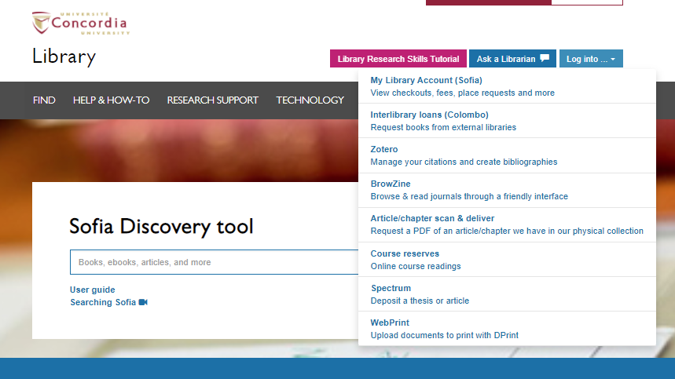
Electronic Course Reserves

Slide 6
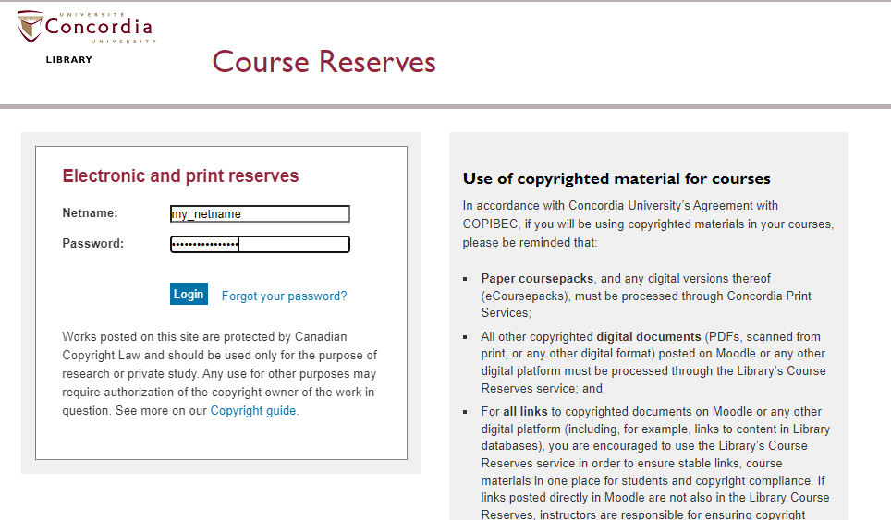

Slide 7
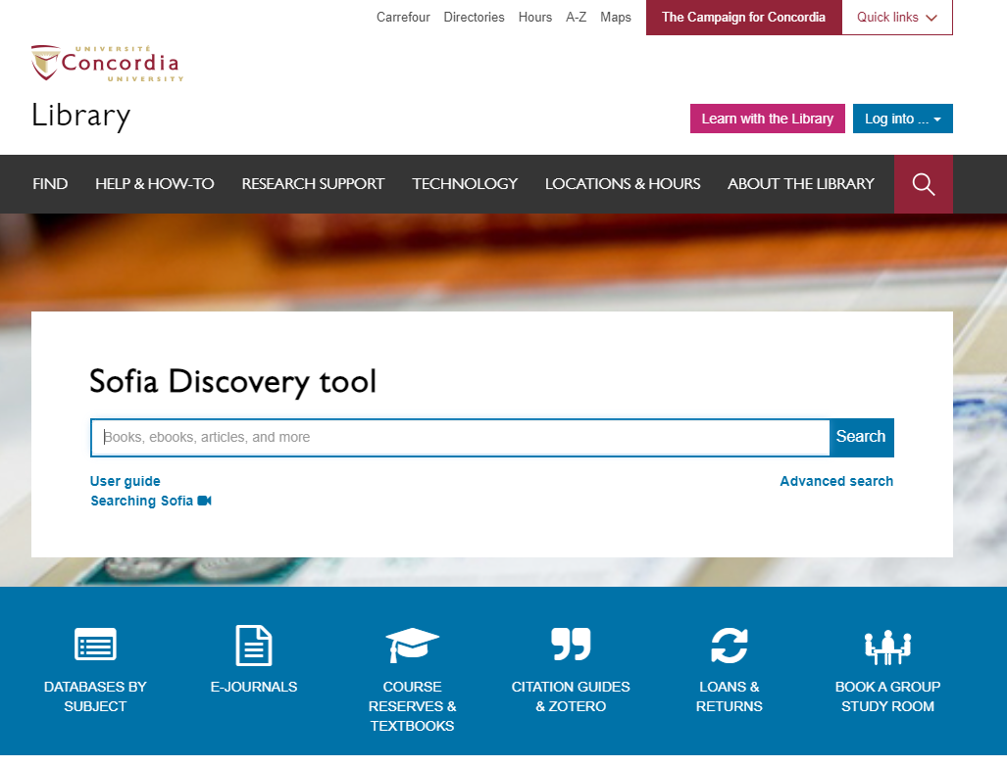
Library website: https://library.concordia.ca/
Use the Sofia Discovery tool to find print books, ebooks, and journal articles from the library.
Book a study room in the library for 2 or more people to use for up to 3 hours

Slide 8
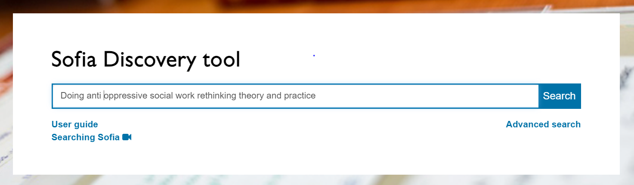
Sofia Search for books – known items

Slide 9
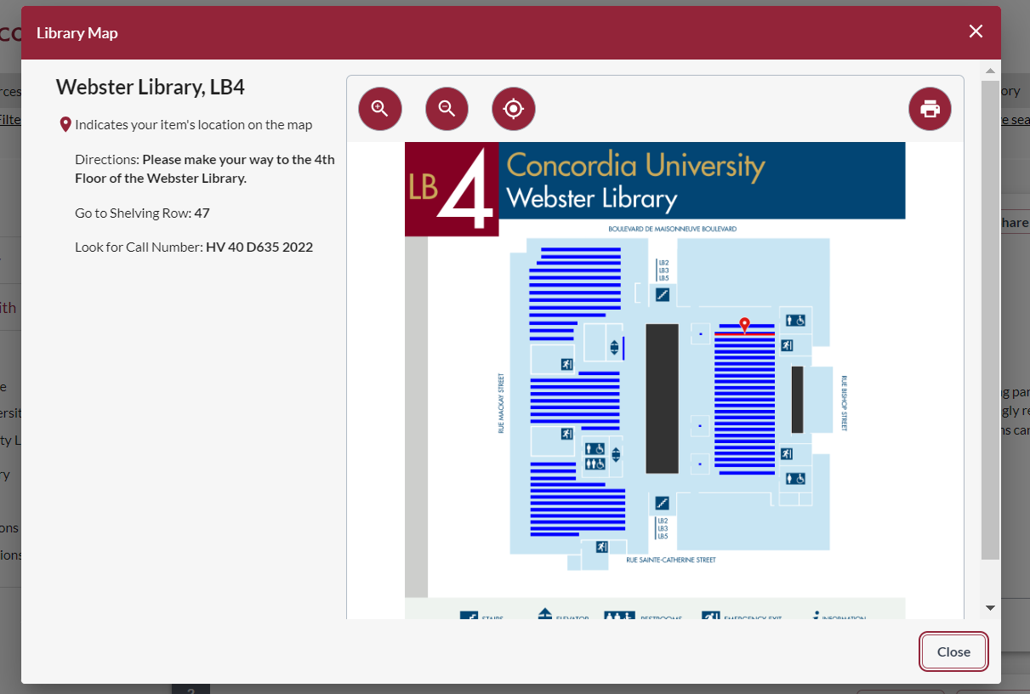
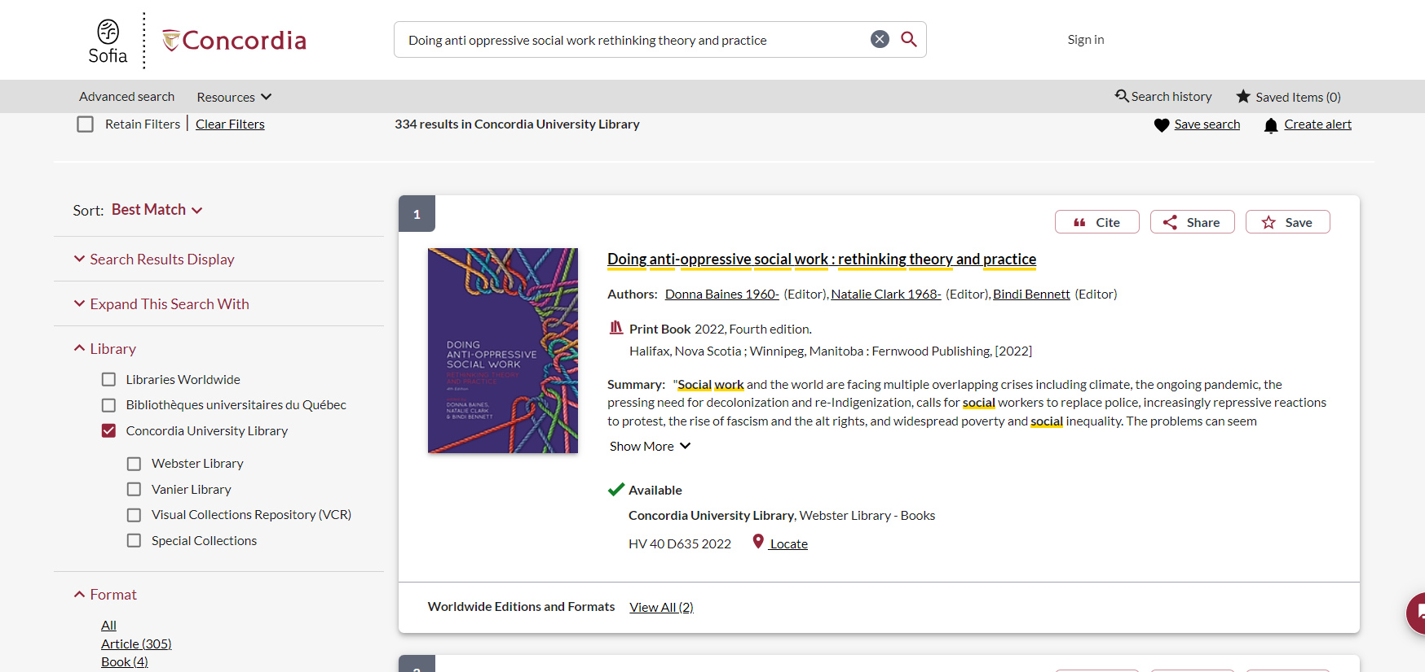

Slide 10
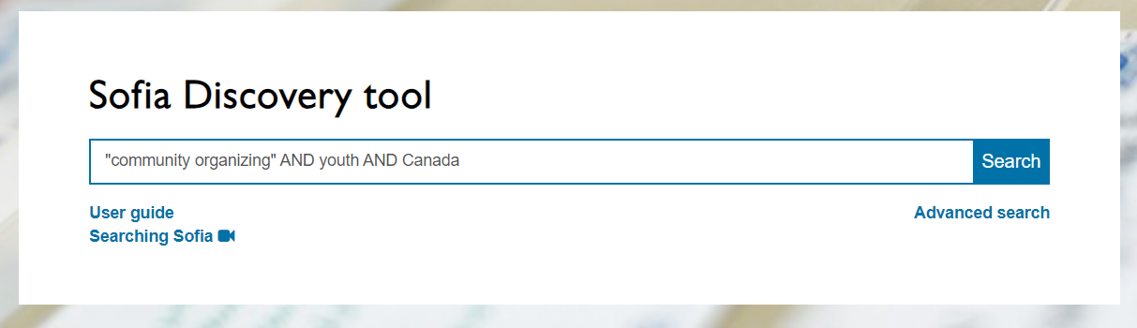
Sofia Search for books – by keyword

Slide 11
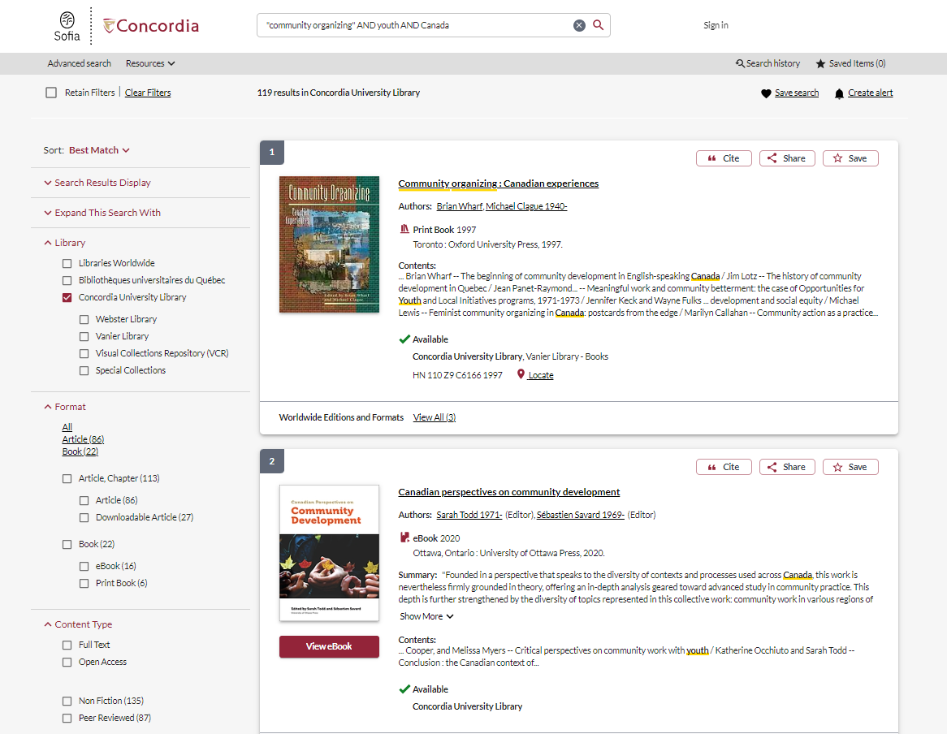
Use the options from this menu to narrow down results

Slide 12
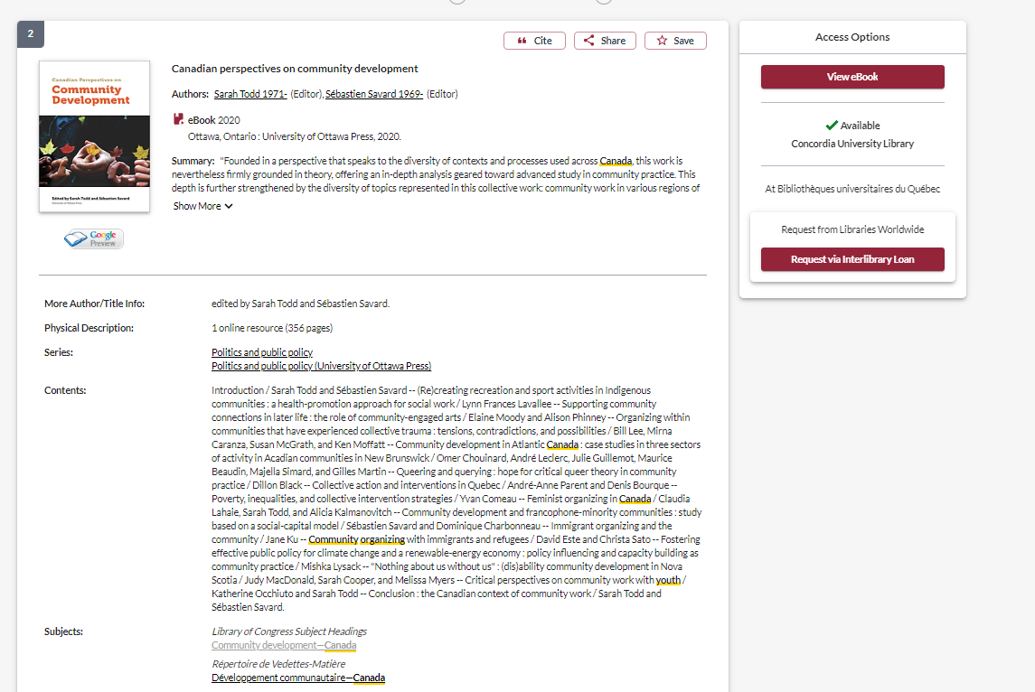
Use the subjects to find other similar resources

Slide 13
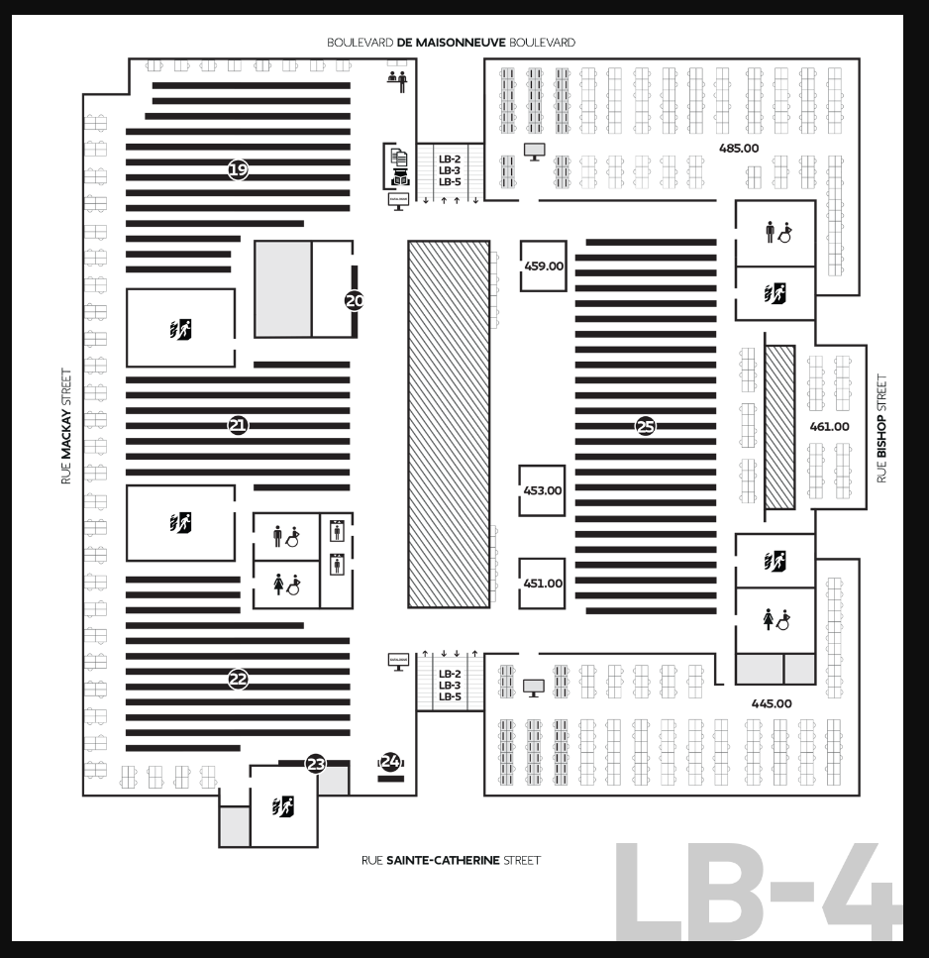
Where to find print books in the library
J-JZ
H-HX
Political Science, political institutions, public administration, land and government J-JZ – 4th floor of Webster Library
Social Sciences, economics, labour, sociology, social history, social problems, families, women, communities, social and public welfare, social work H-HX – 4th floor of Webster Library
Indigenous Peoples in North America E – 3rd floor of Webster Library

Slide 14
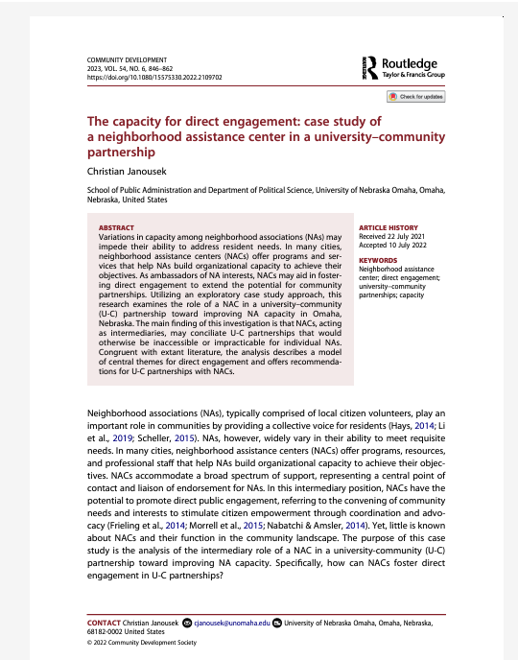
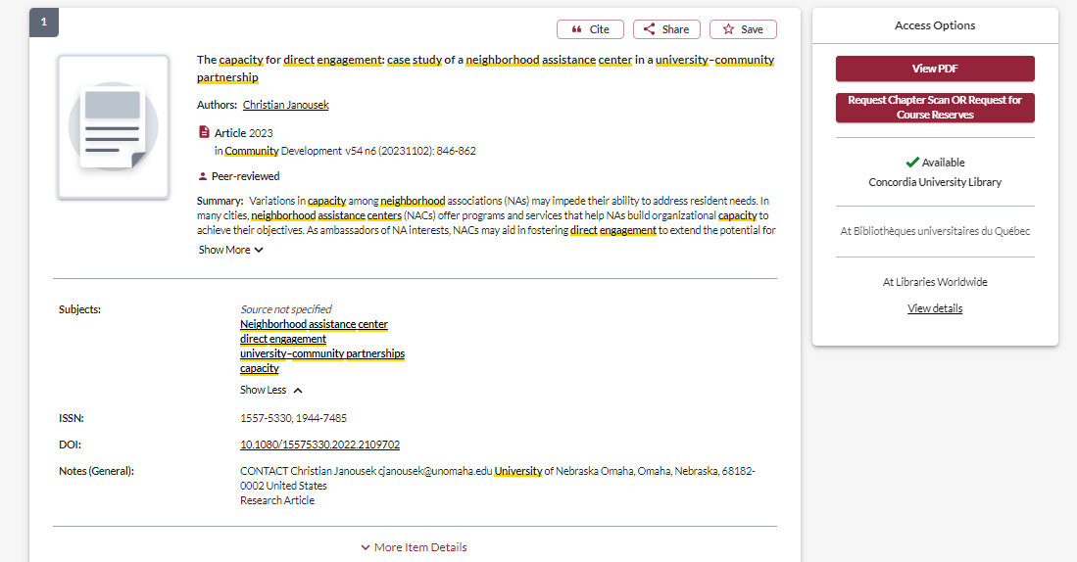
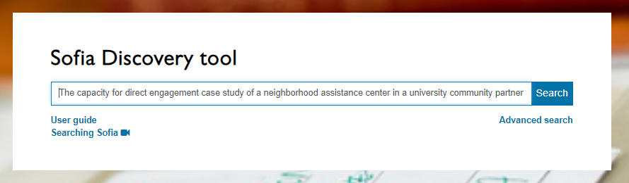
Search for articles

Slide 15
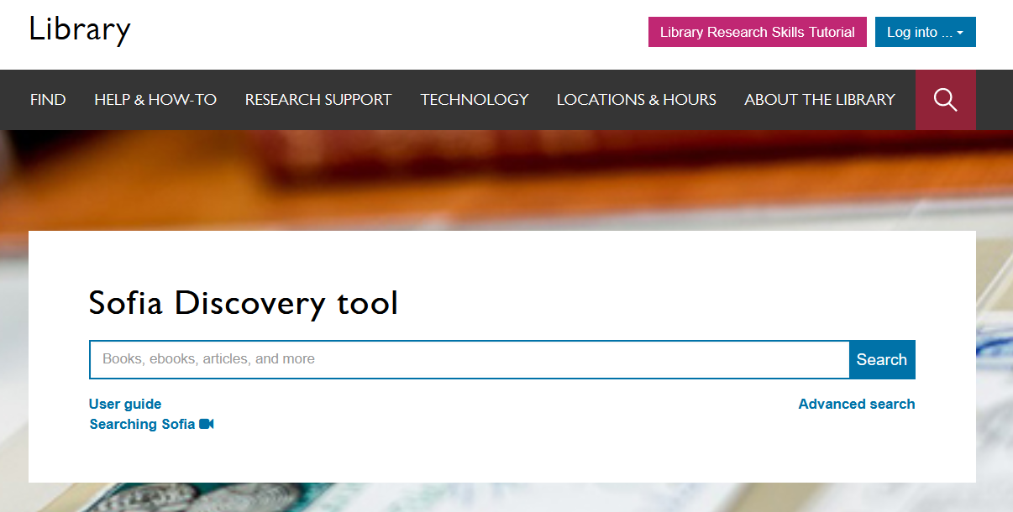
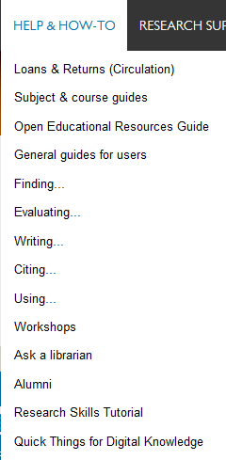

Notes:
You can also access these guides from the main library homepage by clicking on the help and how to menu and then select subject and course guides. These are great place to start for finding databases and other information for your discipline.

Slide 16
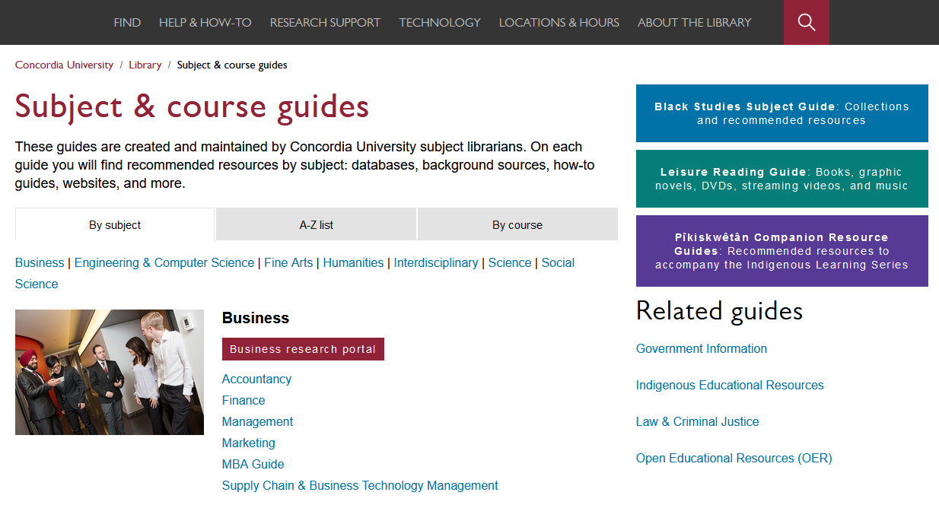
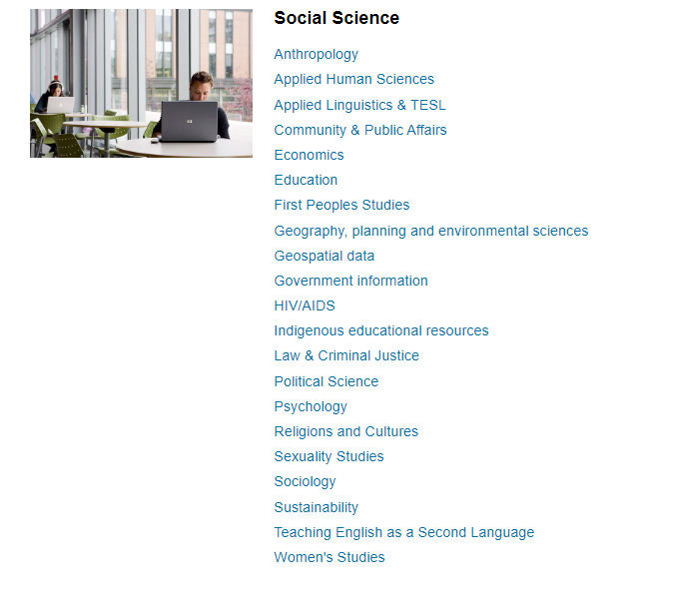
Subject and course guides
Notes:
The subject and course guides are some of the most helpful guides. They are created and maintained by the library’s subject librarians – librarians who are experts at supporting research in your field. The guides contain recommended resources for each subject, including the best databases to use, background sources like encyclopedias and handbooks, how-to guides for finding trickier resources like primary sources, lists of useful websites and online tools. The guides also have links you can use to contact your subject librarians if you have any questions or need help working on a project.

Slide 17
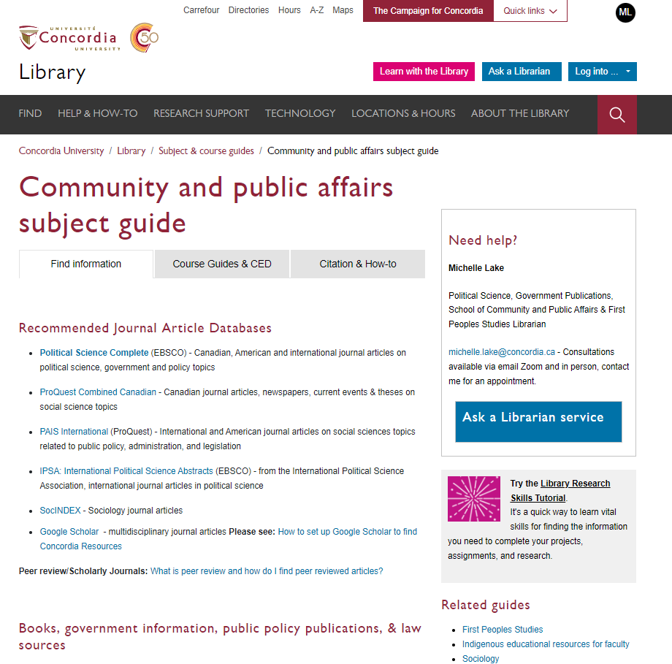

Slide 18
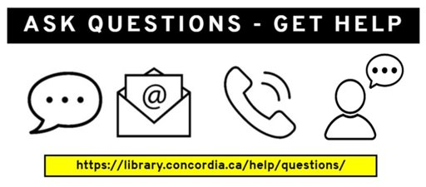
Need help, ask us!

