Slide 1

First Peoples Studies Library Orientation
Michelle Lake
Subject Librarian for First Peoples Studies, SCPA, Poli Sci and Government information
Michelle.Lake@Concordia

Slide 2

Your Subject Librarian
Who am I?
Michelle Lake, librarian for Political Science, the School of Community and Public Affairs, First Peoples Studies and Government Publications
Michelle.Lake@Concordia.ca / Book a one-on-one Zoom consultation or an in-person appointment
What do I do?
  Provide research support
  Teach and assist with library databases and search strategies
  Help you find and access materials, including scholarly materials, Indigenous scholarship, government documents, grey literature, etc.
  Build online guides, resources and pathfinders to help students locate research materials
  Help with citation issues
  Weekly office hours at the Otsenhákta Student Centre (OSC)
  Choose the books we buy for my subject areas: First Peoples studies, political science, public policy, community and public affairs and government information

Slide 3
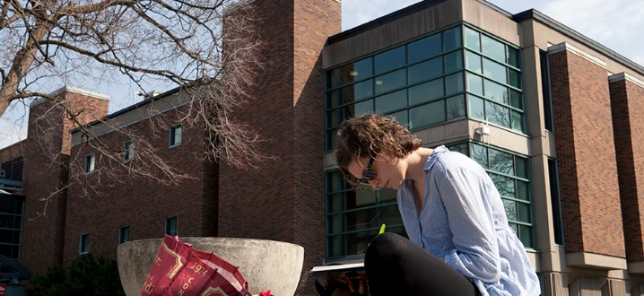
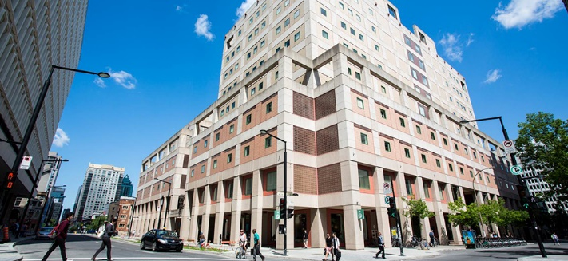
The Librar(ies)
Open 24/7 in Fall and Winter semesters, with student card, after 11pm
Webster Library (LB) – downtown on SGW campus & Vanier Library (VL) on Loyola campus
Webster: Social Sciences, Humanities, Business, Engineering & Fine Arts
Vanier: Science(s), Health, Communications, Journalism and Psychology
Course Reserves Room(s): have the required undergraduate print textbooks for the courses taught at that campus (for example: Webster has the FPST, Political Science and SCPA course reserves)

Slide 4

Library Services
Your student card is your library card.
You need it to:
borrow books (up to 100 a time)
borrow a laptop (for 3 days) and other technology like tablets, chargers, headphones and cameras
print on campus (add money to your Dprint account)
access the library overnight during 24/7 hours.
Webster library has 5 book scanners (And Vanier has 2!) that can be used for free to scan chapters from our print books and email them to yourself as a PDF.
To use Library databases, access online articles and ebooks when you are off campus, login with your MyConcordia Netname and password.

Slide 5
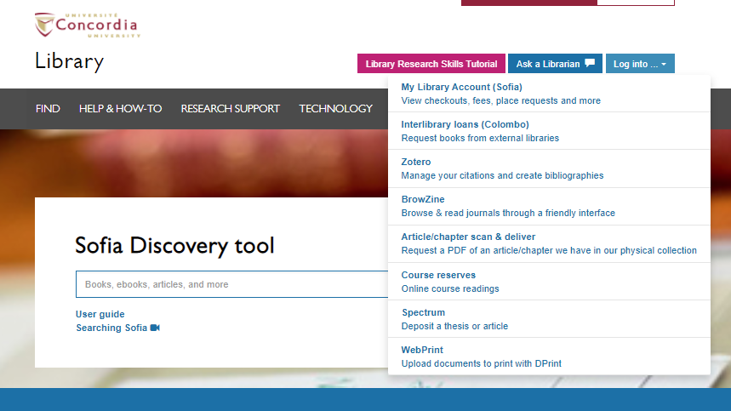
Electronic Course Reserves

Slide 6
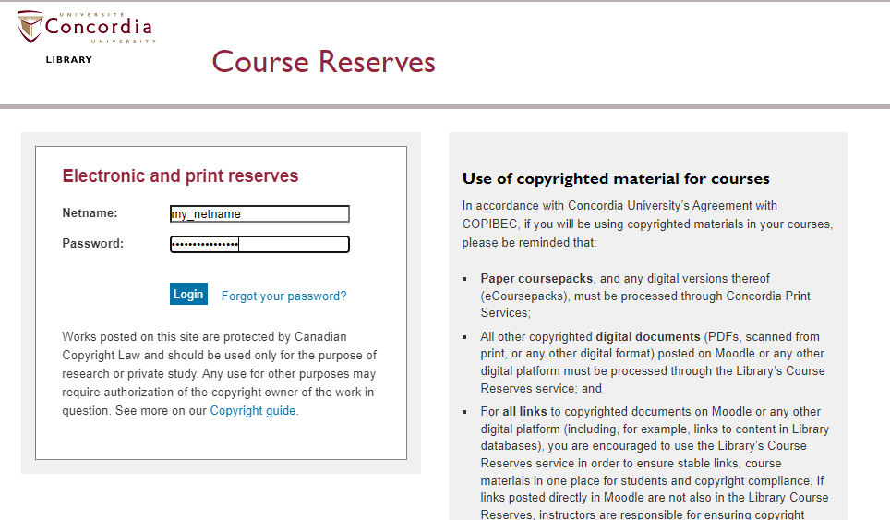

Slide 7
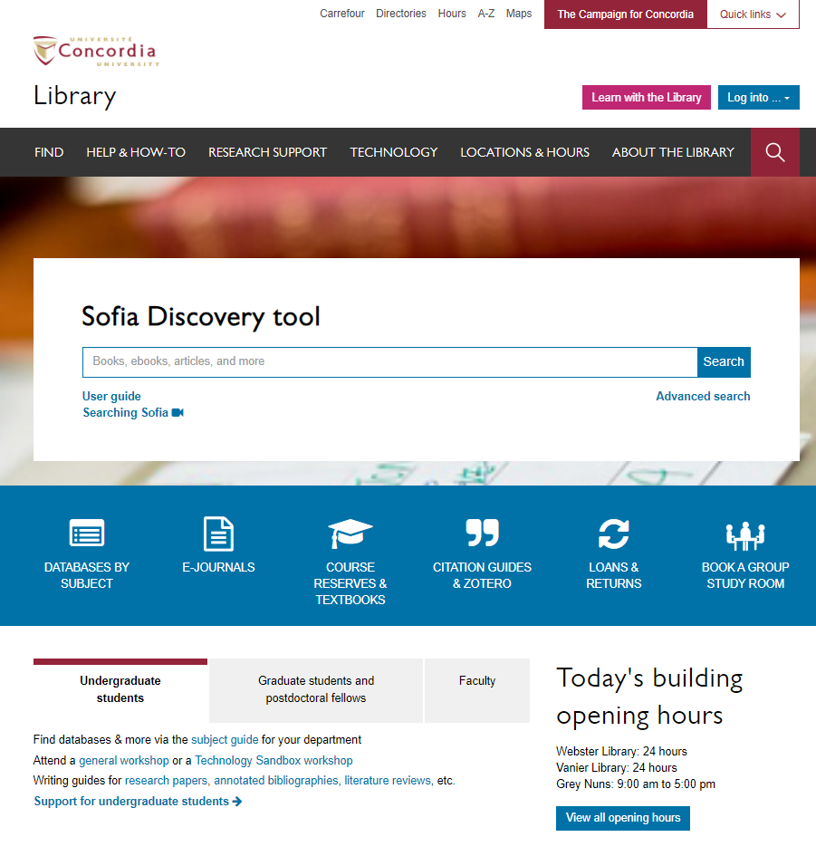
Library website: https://library.concordia.ca/
Use the Sofia Discovery tool to find print books, ebooks, and journal articles from the library.
Book a study room in the library for 2 or more people to use for up to 3 hours
Find your subject guide for your topic area

Slide 8
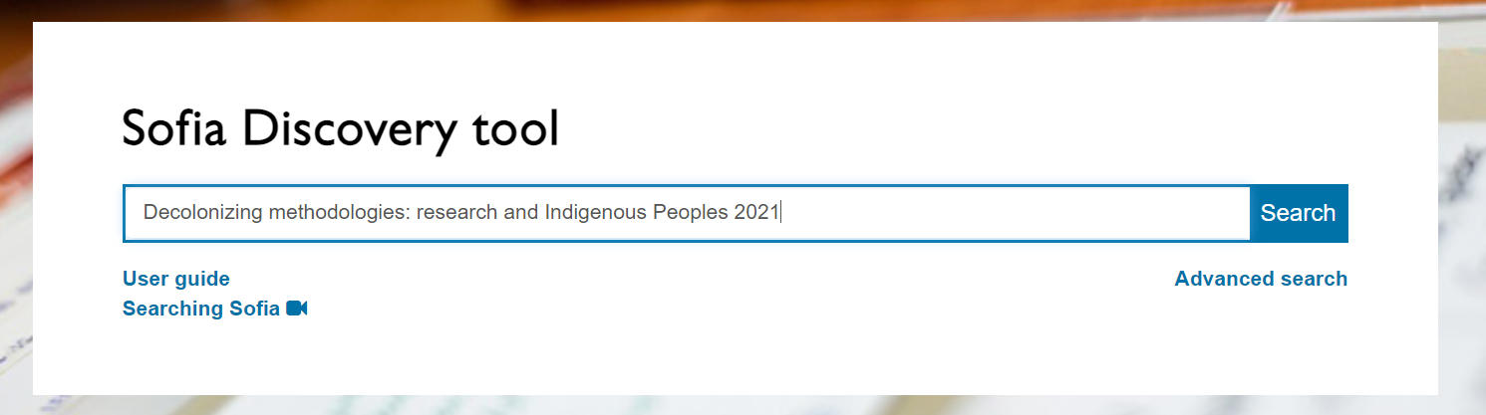
Smith, Linda Tuhiwai. (2021). Decolonizing methodologies: research and Indigenous Peoples. Zed Books.

Slide 9
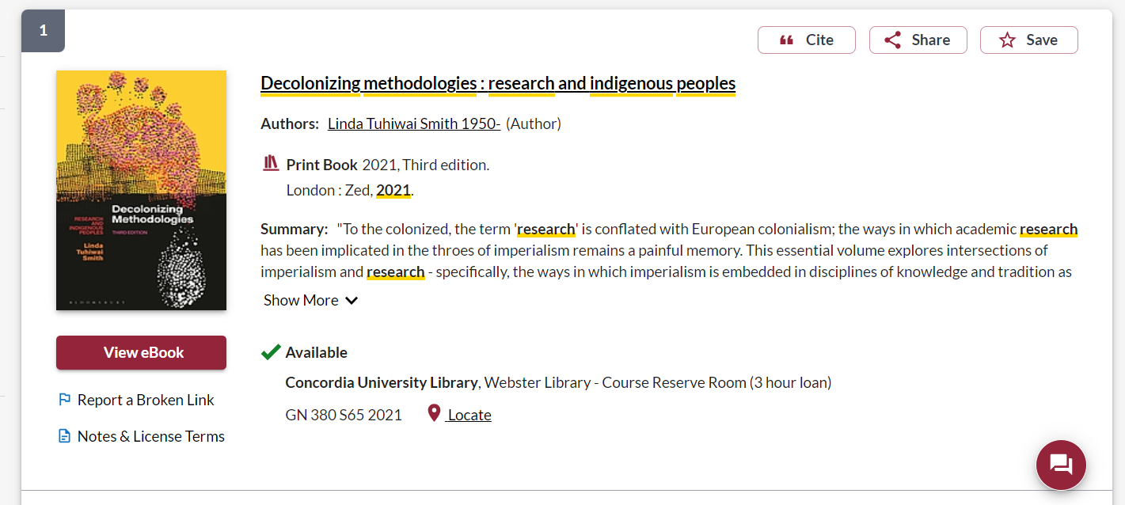
There is also an ebook copy that can be accessed online.
The print copy of the book is in the Course reserves room and can be borrowed for 3 hours. Or chapters can be scanned from the book, using the book scanner.

Slide 10
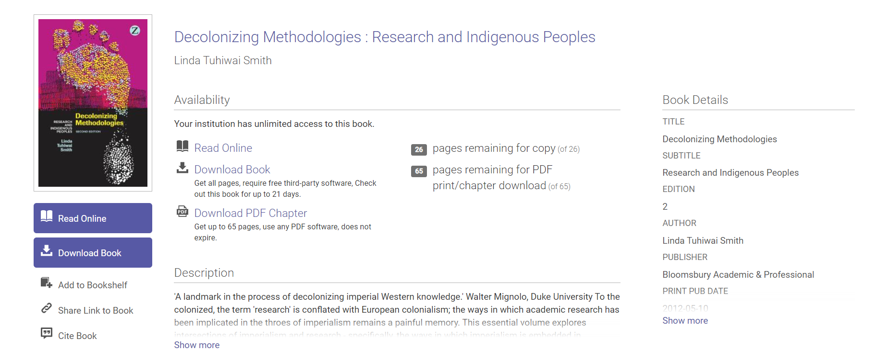
The is the ebook version, where you can read the book online, or download up to 65 pages in the book as a PDF.

Slide 11
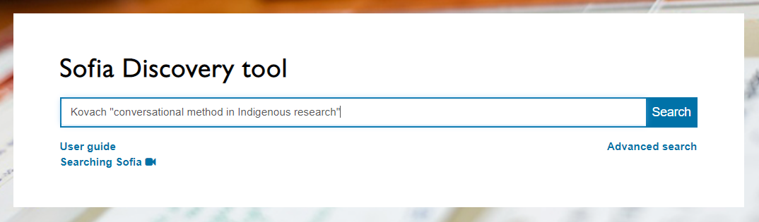
Kovach, M. (2010). Conversational method in Indigenous research. First Peoples Child & Family Review, 5(1), 40-48.

Slide 12
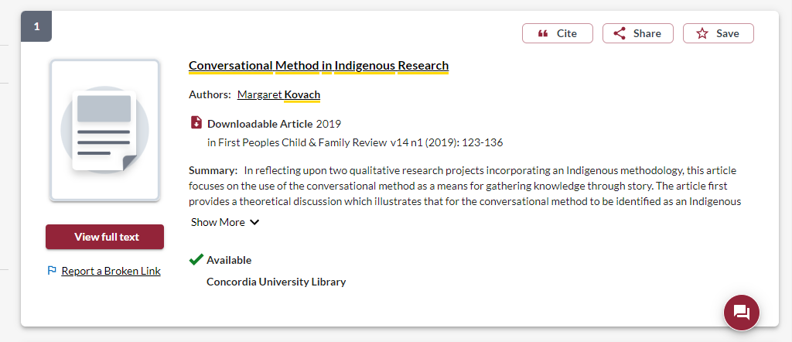
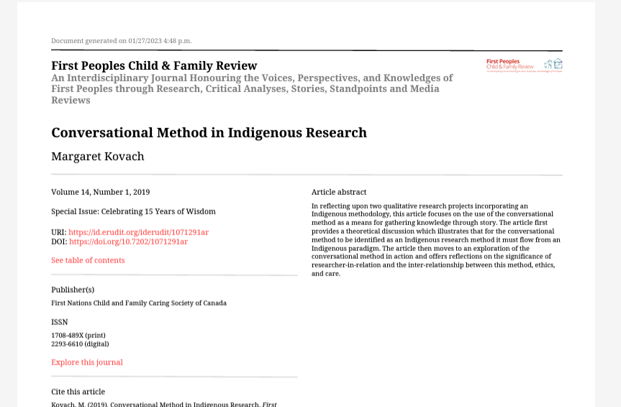

Slide 13
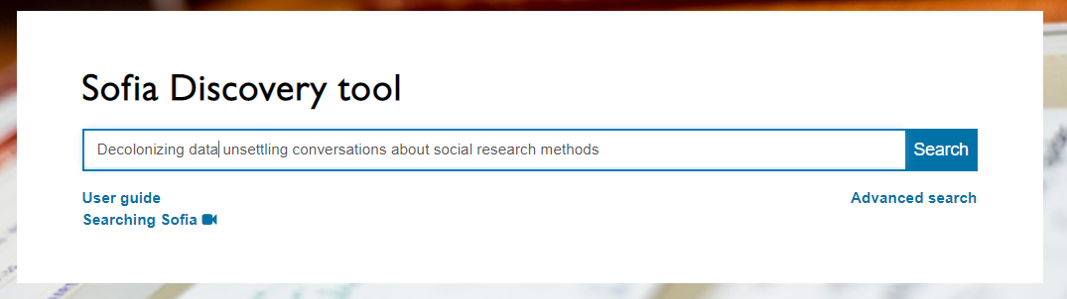
Quinless, J.M. (2022). Decolonizing data: unsettling conversations about social research methods. Toronto: University of Toronto Press.

Slide 14
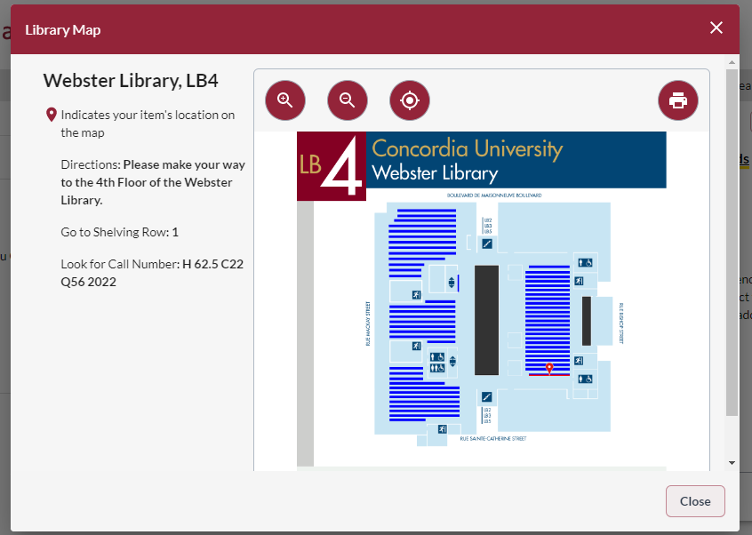
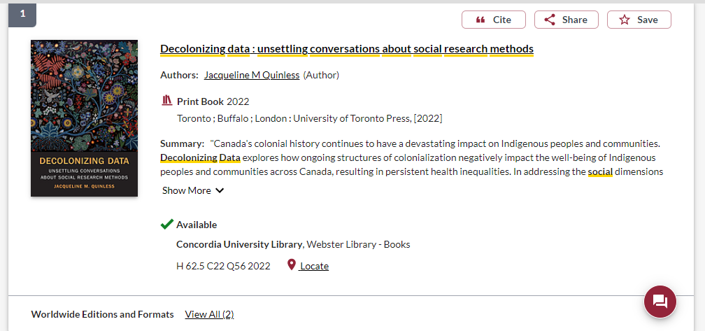

Slide 15
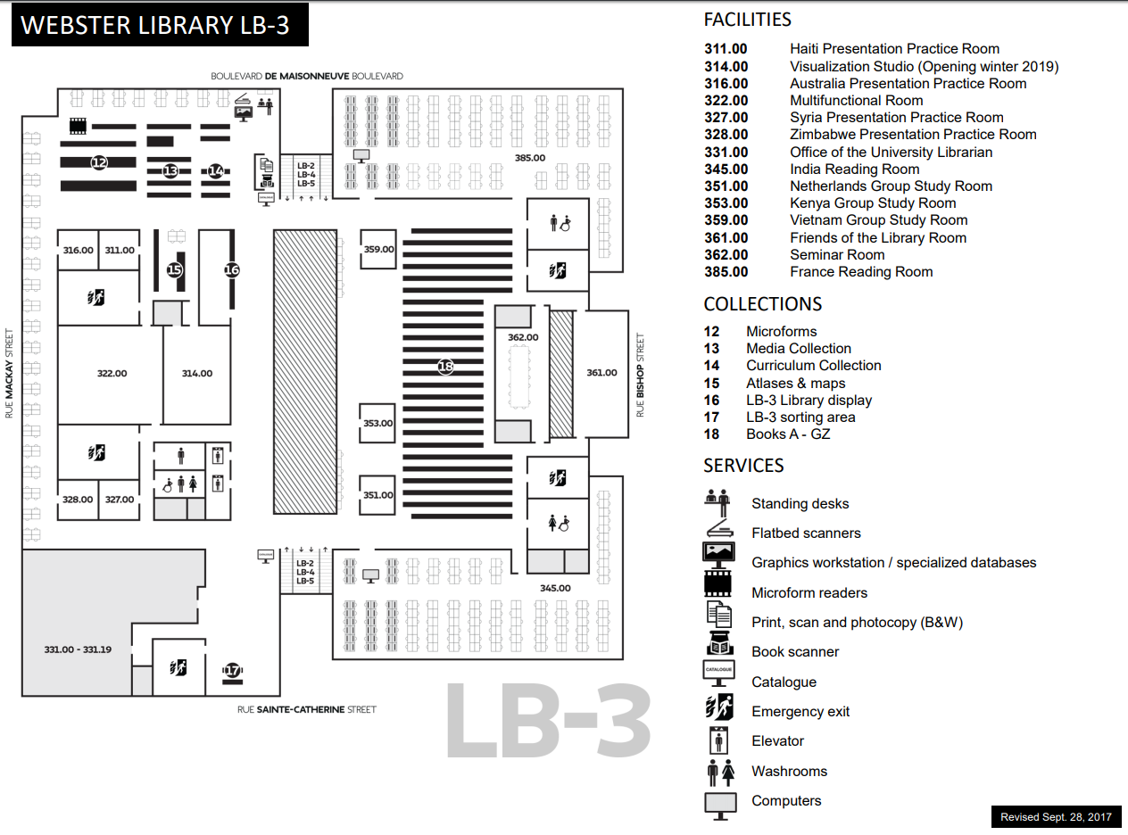
E, F and FC books are here
Call number ranges:
E 75 – E 99 Indigenous Peoples in North America
F 1-1140 History of British America (Canada)
FC 1-4200 Canada

Slide 16
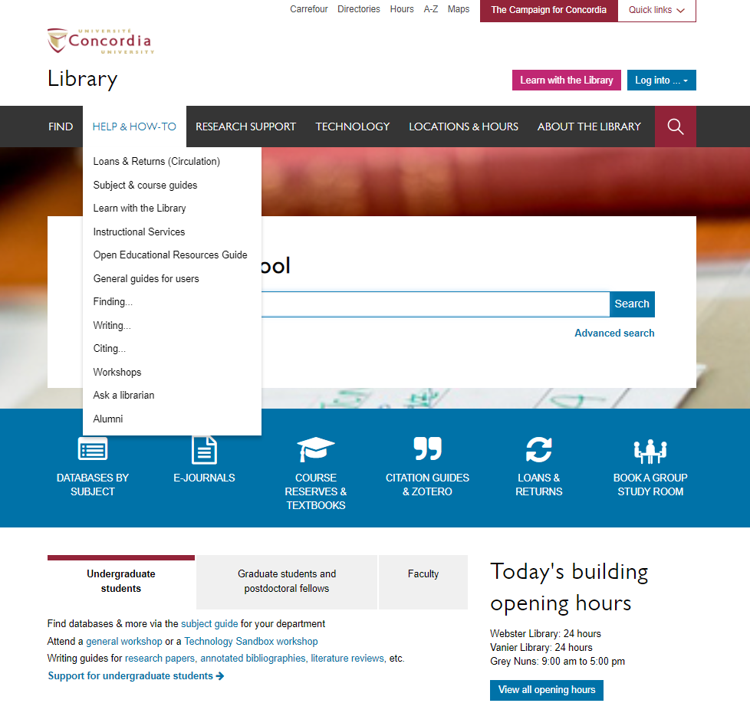

Slide 17
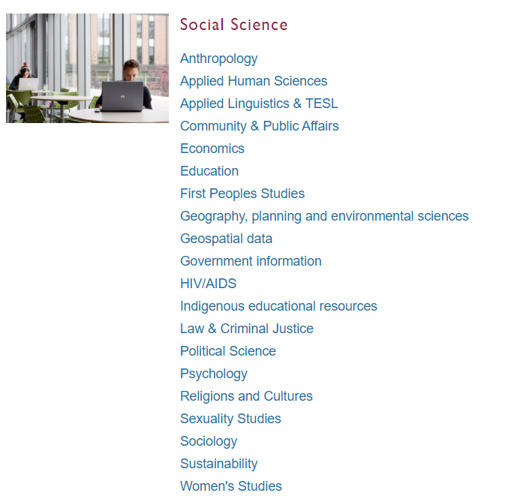
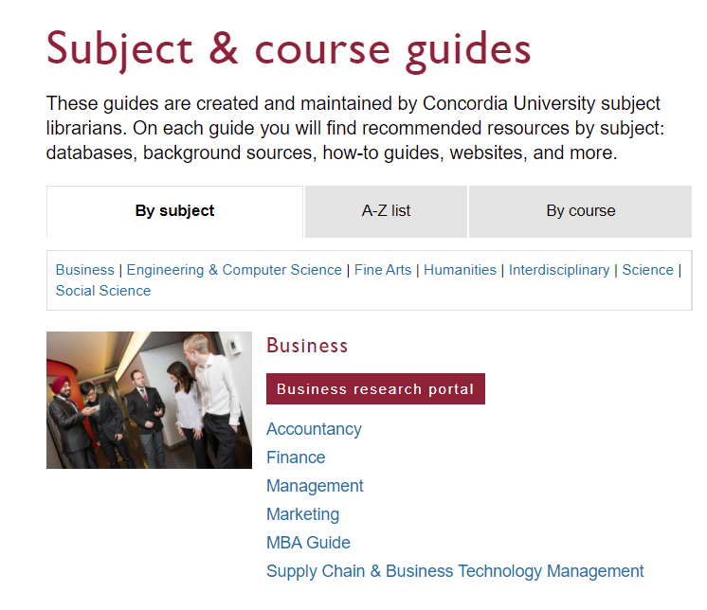
Subject Guide: First Peoples Studies

Slide 18
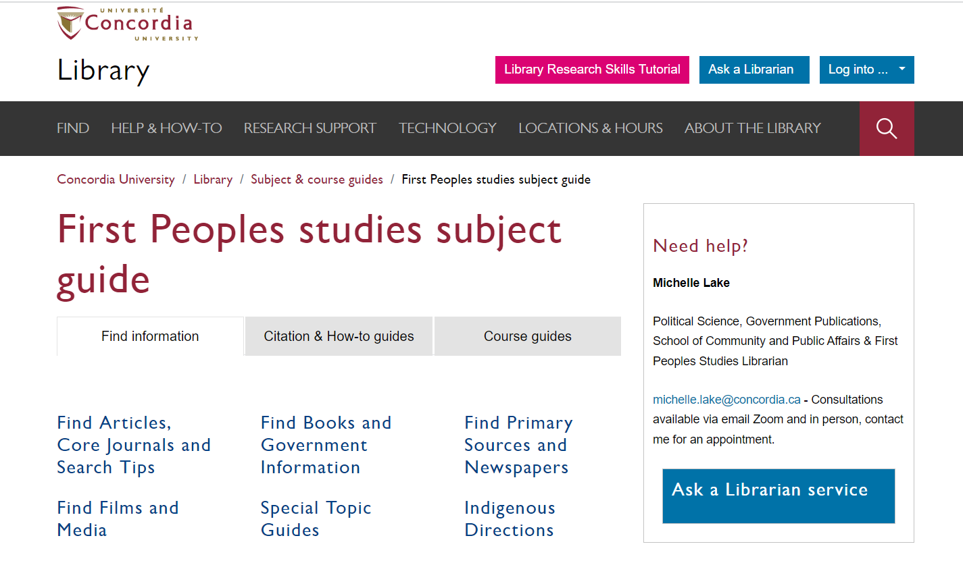

Slide 19
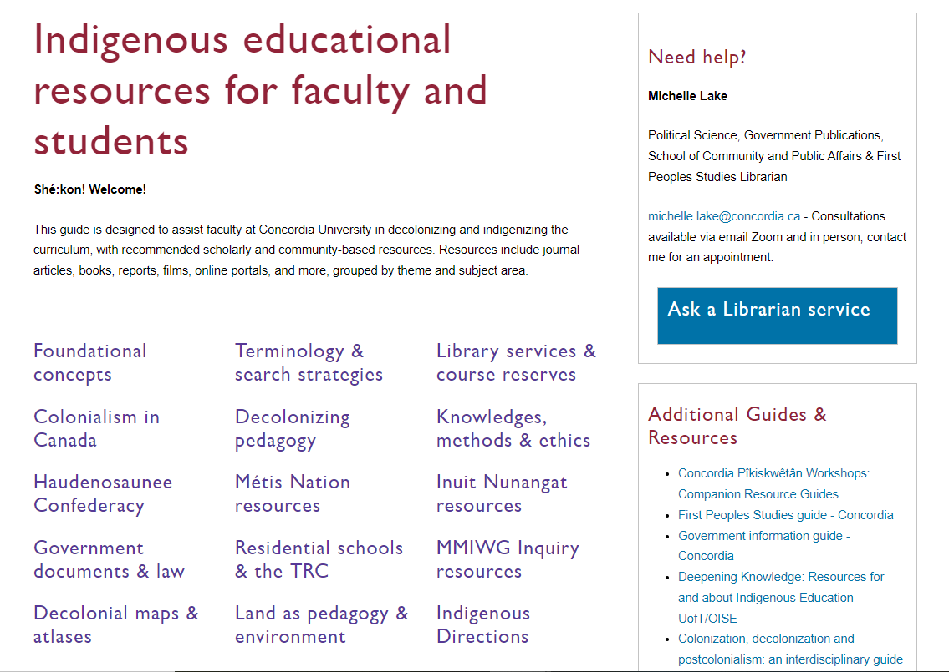
Each of these topic areas has suggested readings, which may include journal articles, books, websites and even films.
Not all of the materials are by Indigenous authors, but again this is a good place to browse.

Slide 20
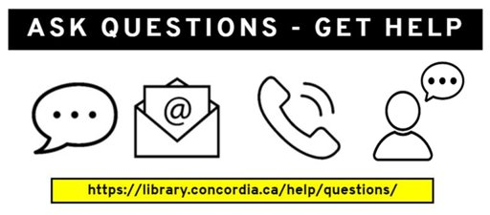
Need help, ask us!

