Slide 1
POLI 322: Israeli Political System Library Workshop
Michelle Lake
Political Science, SCPA, FPST and Government Information Librarian
Michelle.Lake@Concordia.ca

Slide 2
Who am I?
Michelle Lake, librarian for Political Science, the School of Community and Public Affairs, First Peoples Studies, and Government Publications
Michelle.Lake@Concordia.ca / Make an appointment or ask a question
What do I do?
Provide research support
Help students with library databases
Help students find and access materials they need
Help with citation issues
Choose the books we buy for the above subject areas

Slide 3
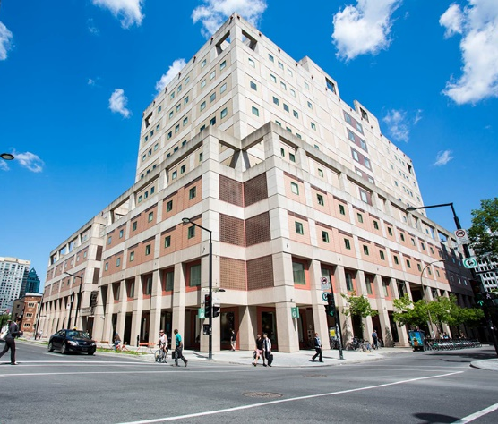
The Librar(ies)
24/7 access, with student card, after 11pm
Webster Library (LB) – downtown on SGW campus & Vanier Library (VL) on Loyola campus
Webster: Social Sciences, Humanities, Business, Engineering & Fine Arts
Vanier: Science(s), Health, Communications, Journalism and Psychology
Course Reserves Room(s): have the required undergraduate print textbooks for the courses taught at that campus (for example: Webster has the Political Science and SCPA course reserves)

Slide 4
Library Services
Your student card is your library card.
You need it to:
borrow books (up to 100 a time)
borrow a laptop and other technology (for 24 hours)
print on campus (add money to your Dprint account)
access the library overnight during 24/7 hours.
Webster library has 5 book scanners (And Vanier has 2!) that can be used for free to scan chapters from our print books and email them to yourself as a PDF.
To use Library databases, access online articles and ebooks when you are off campus, login with your MyConcordia Netname and password.

Slide 5
How can I find out if the library has access to an item I’m looking for?

Slide 6
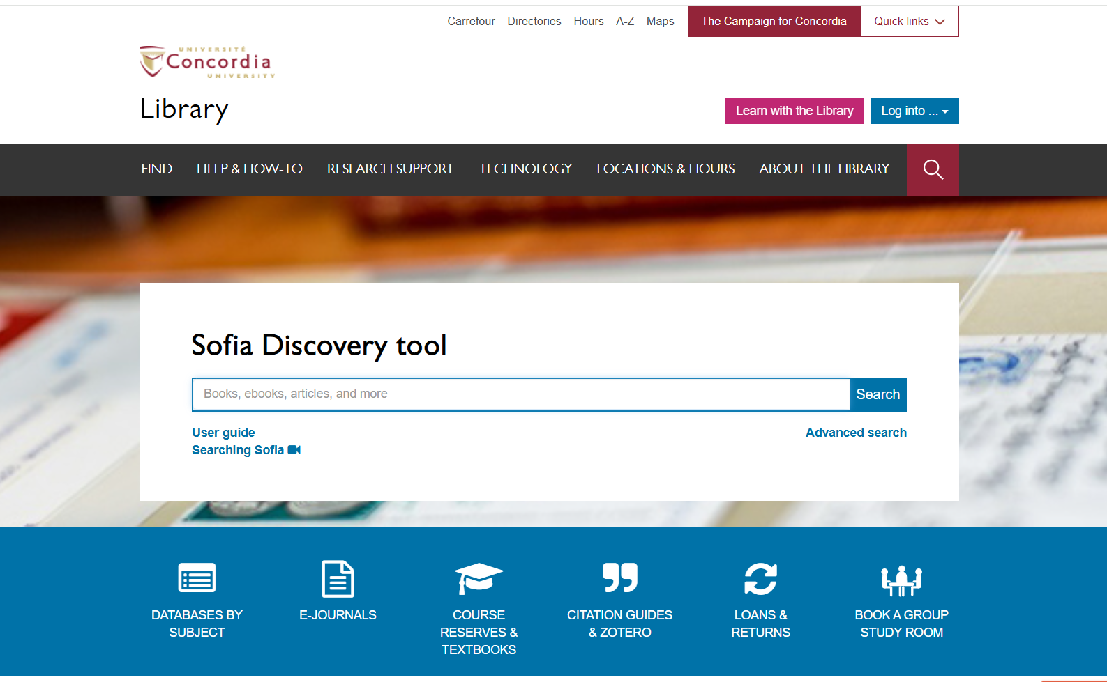

Slide 7
The Oxford Handbook of Israeli Politics and Society edited by Reuven Y. Hazan, et al., Oxford University Press, 2021.

Slide 8
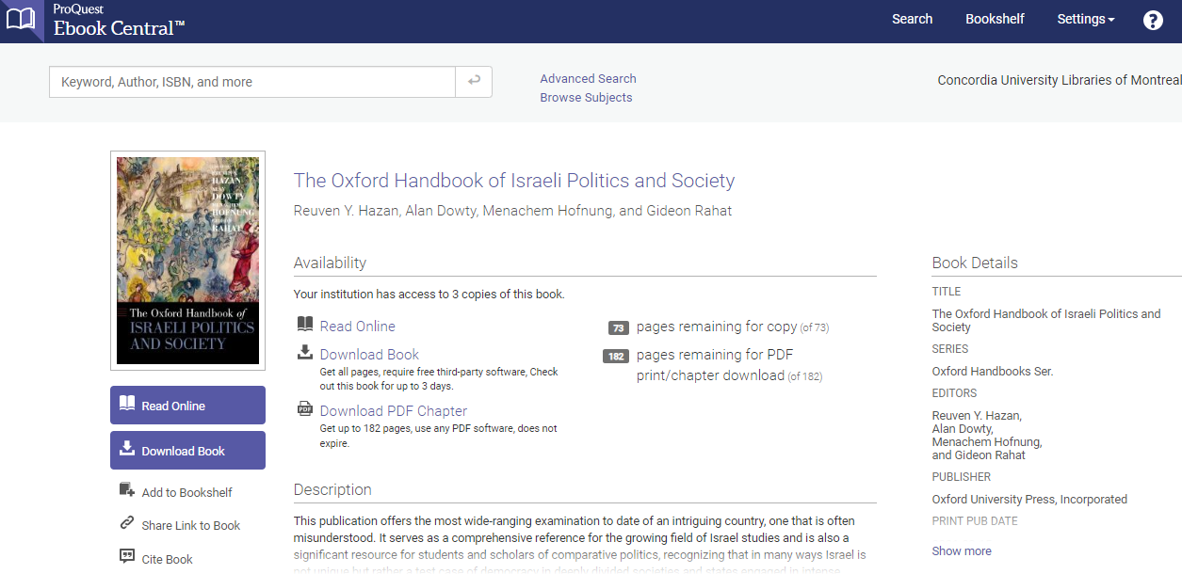
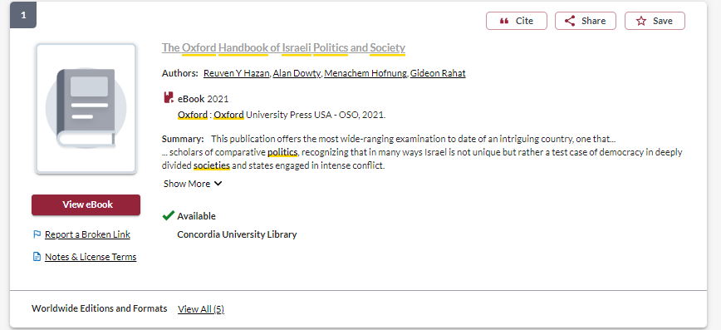

Slide 9
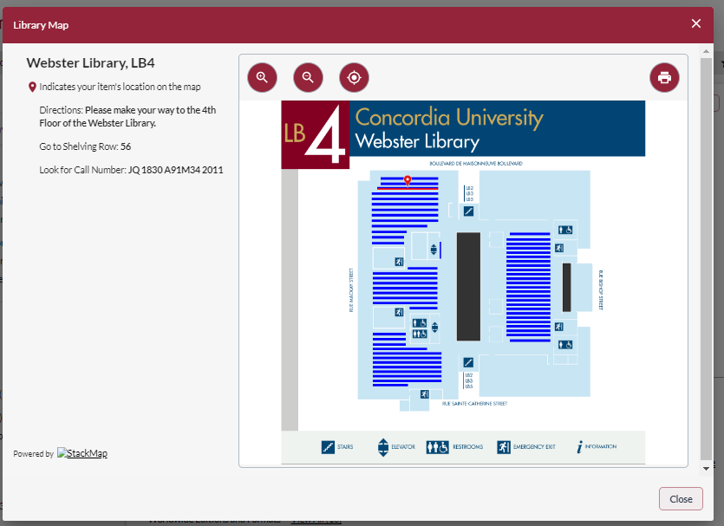
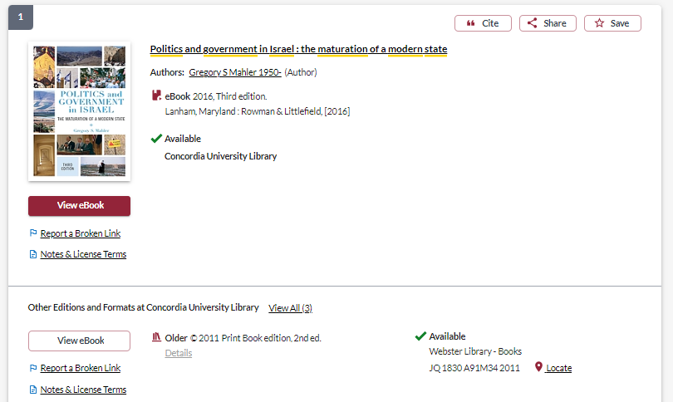
Access online
Borrow or scan chapters from the print book

Slide 10
Nikolenyi, C. (2020). The 2018 Municipal Elections in Jerusalem: A Tale of Fragmentation and Polarization. Contemporary Review of the Middle East, 71(1): pp. 6-24.

Slide 11
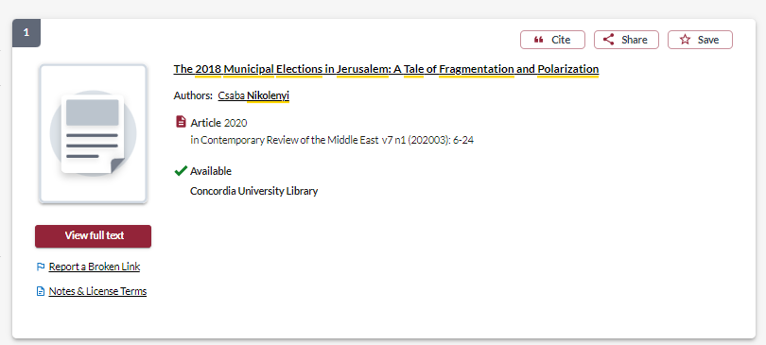
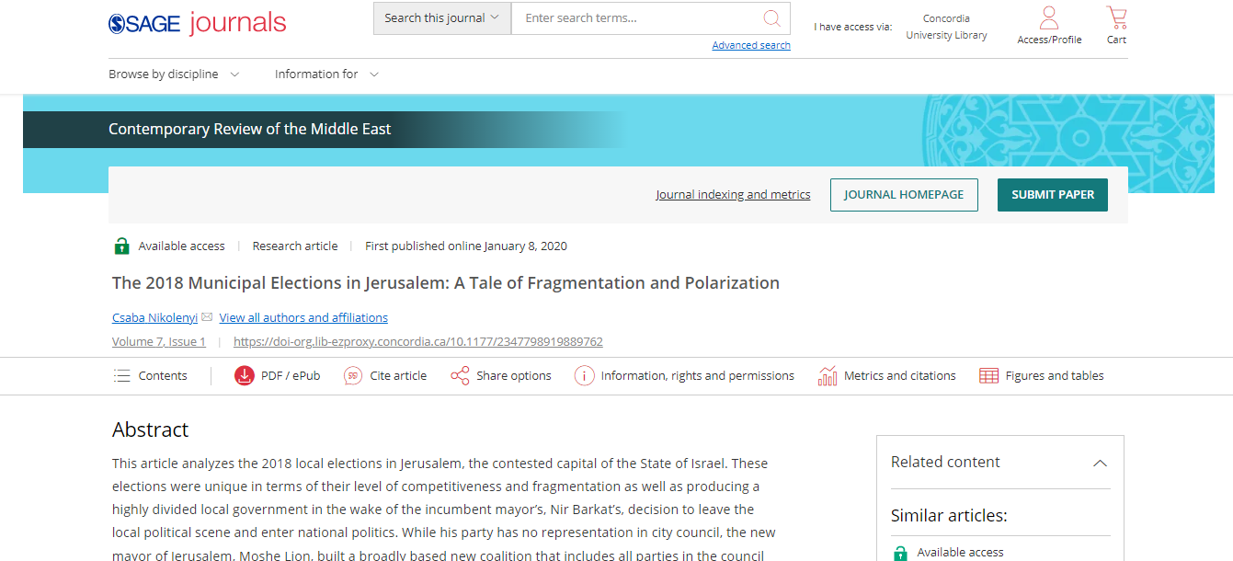

Slide 12
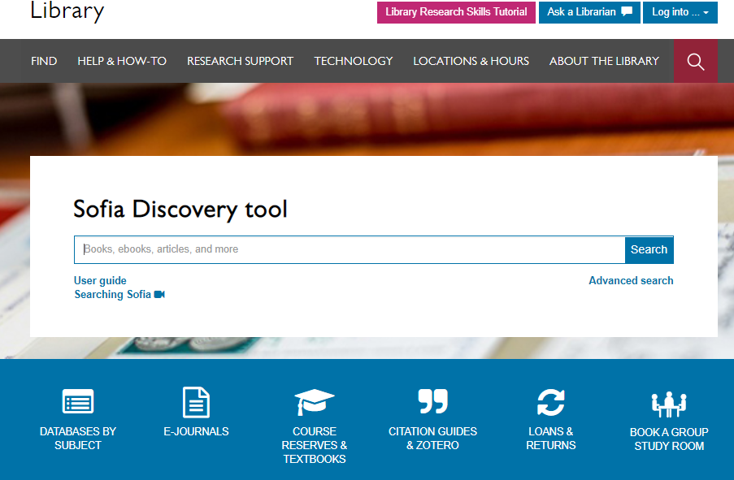

Slide 13
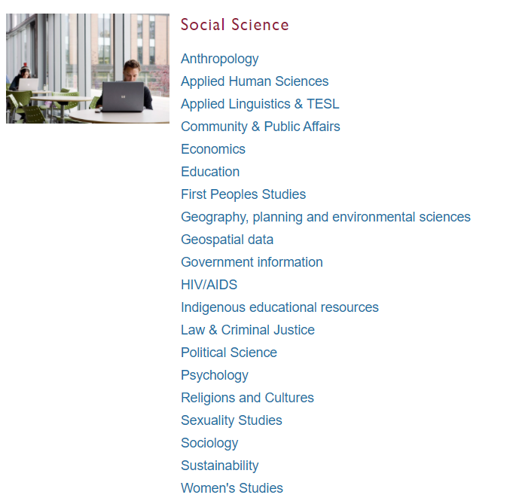
Subject Guide: Political Science

Slide 14
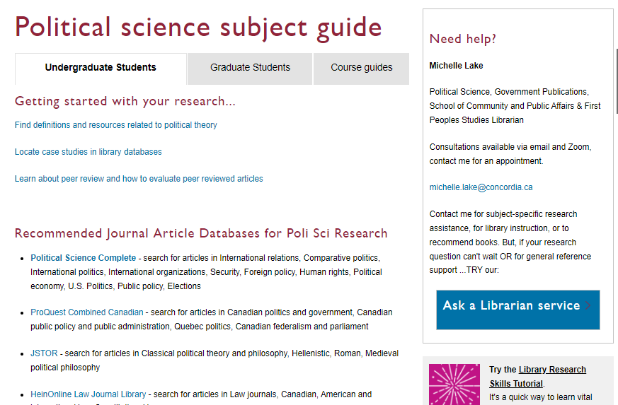

Slide 15
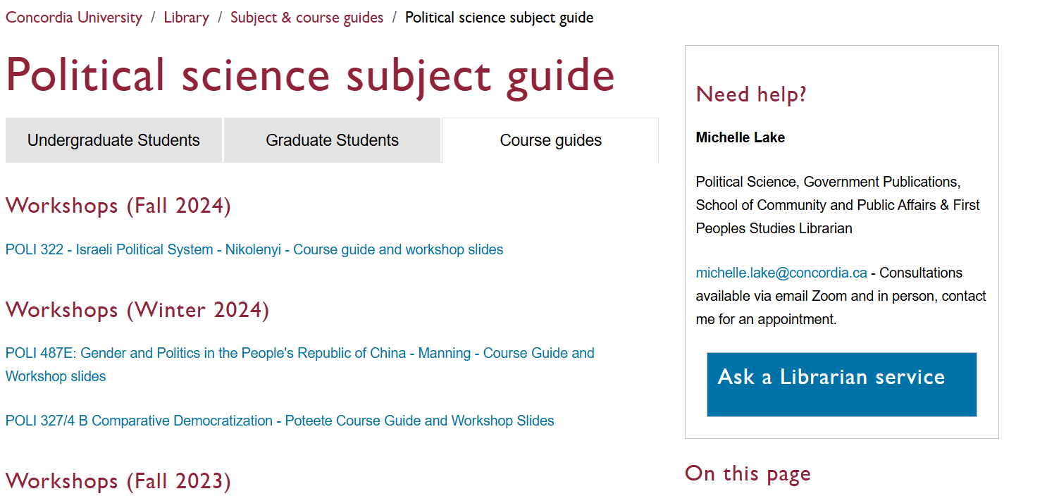

Slide 16
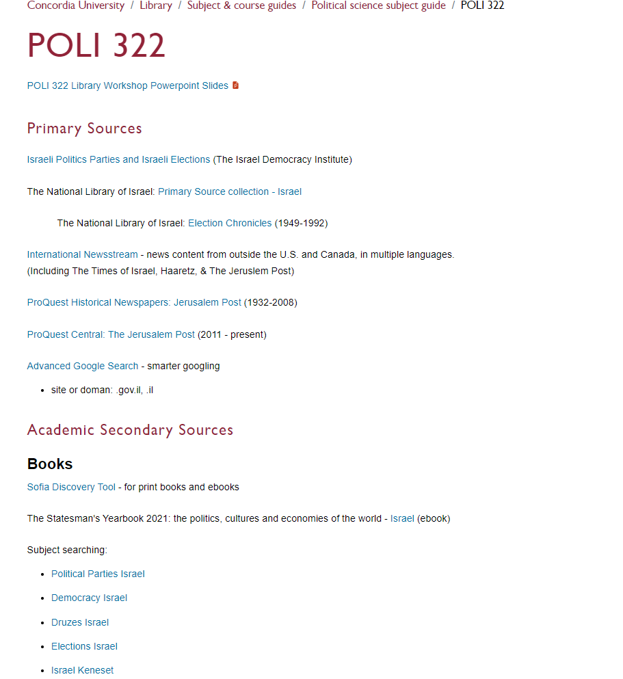
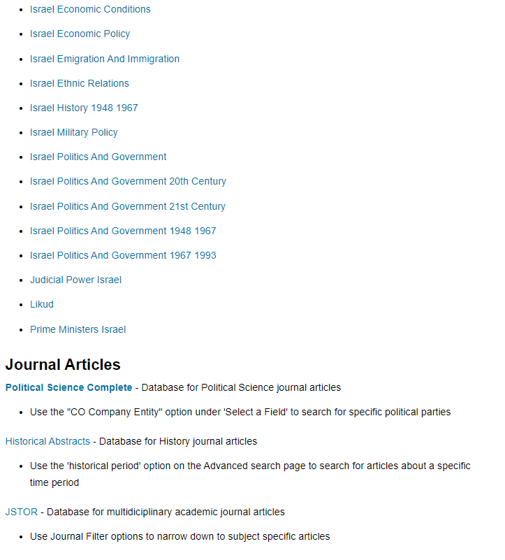

Slide 17
Types of sources
Primary sources: are first-hand testimony or direct evidence concerning a topic under investigation. Created by witnesses or recorders who experienced the events or conditions being documented.
Includes government publications, websites or statistics written and published by governments, publications and websites written and published by international organizations, non-governmental organizations, independent institutions, news and media sources including newspapers, news websites and other media.
Academic Secondary Sources: books and journal articles written by academic researchers, affiliated with universities, colleges and other academic institutions, usually having gone through a peer review process. Published by university presses and in academic journals.

Slide 18
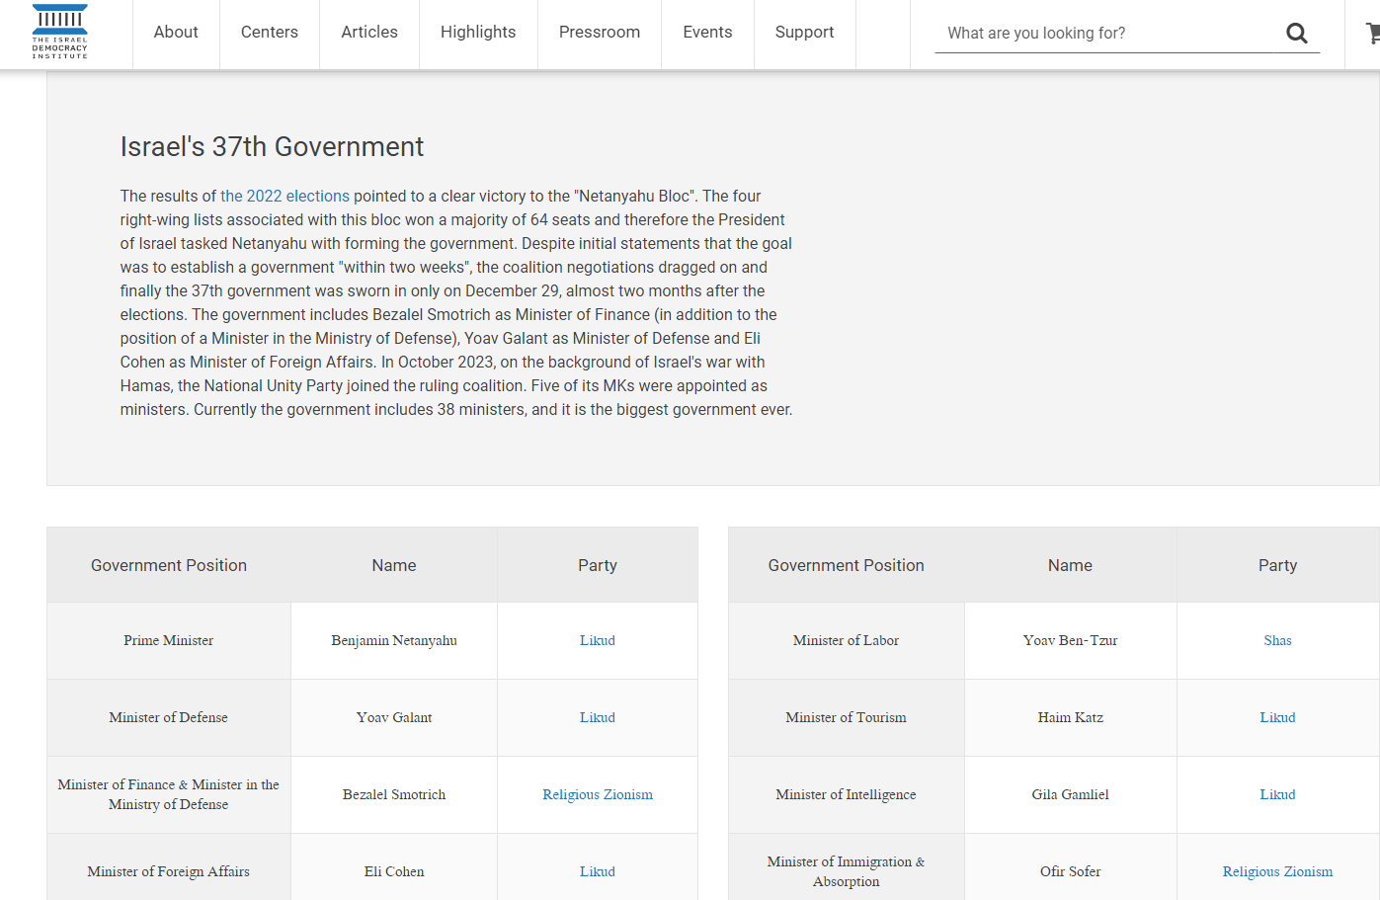
Israel Democracy Institute
Click to find more information on the most recent election
Click on each party name for background information, candidates and election results

Slide 19
National Library of Israel: Primary Sources & Election Chronicles

Slide 20
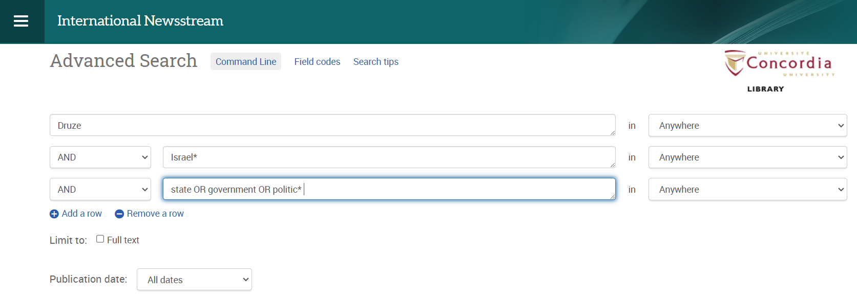
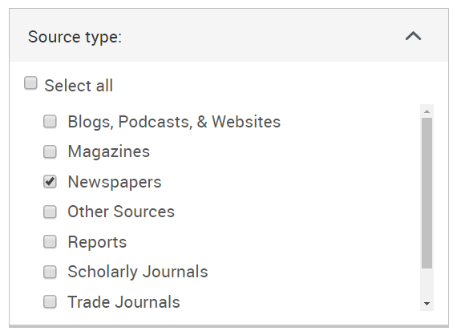
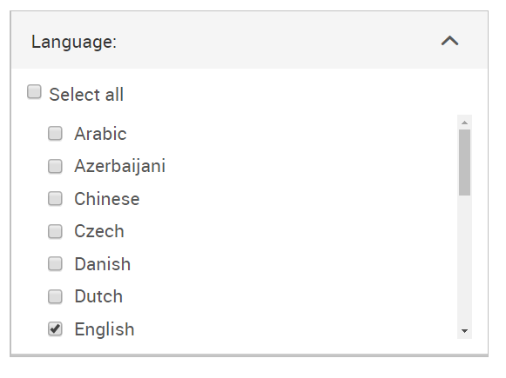
Searching News sources: International Newsstream

Slide 21
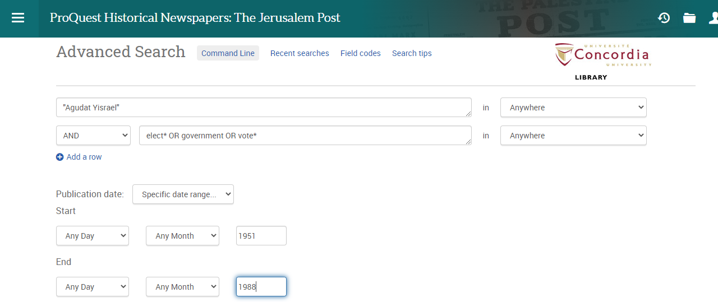
Searching news sources: Jerusalem Post

Slide 22
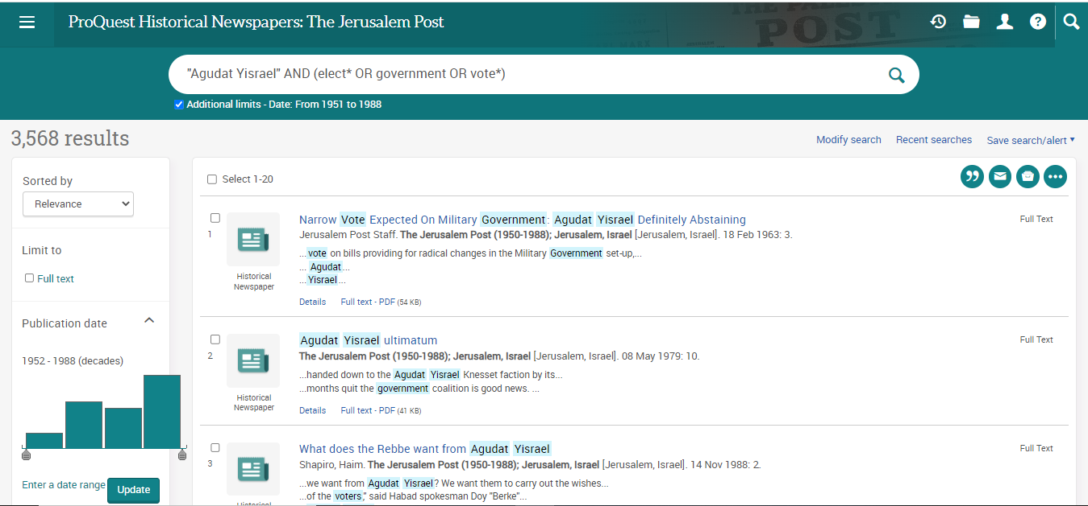
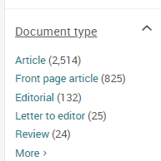

Slide 23
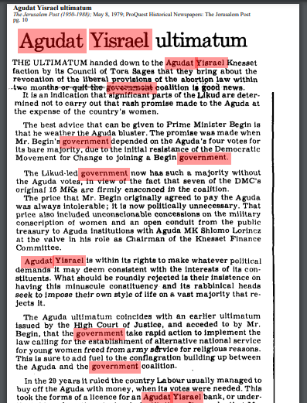
Searching news sources: Jerusalem Post
This database is an online archive and all the historical newspaper images have been scanned as PDFs.
When you search for keywords, they will be highlighted throughout the scanned image.
You can download and save the PDF images of the newspaper.

Slide 24
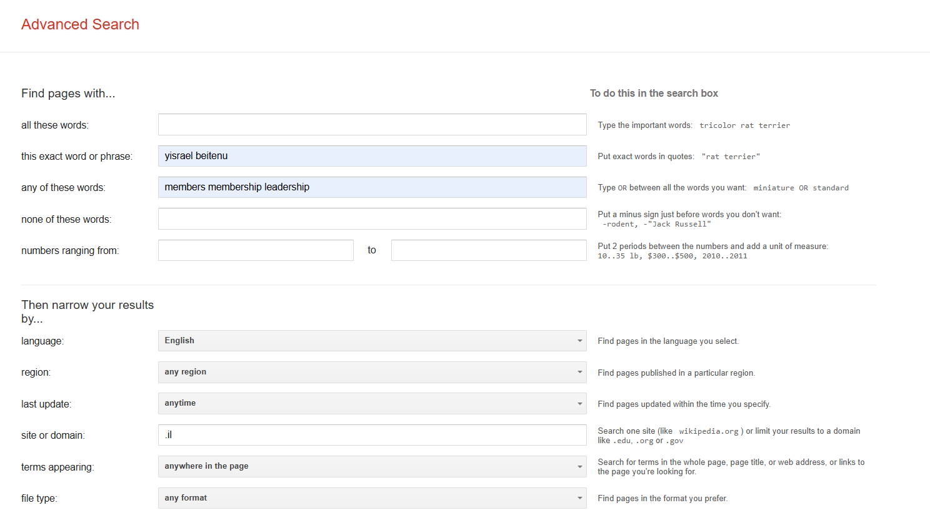
Advanced Google – searching smarter
AND
“phrase search”
OR

Slide 25
Scholarly Sources: Books and Articles

Slide 26
How do we combine search words for the best possible results?
AND: combines concepts and limits your results
politics AND security
state OR government
election OR voting
OR: allows you to insert synonyms or alternative terms and increases your results

Slide 27
How do we combine search words for the best possible results?
“quotation marks”: If you put two or more words in quotation marks, that exact phrase will be searched and limits your results.
“political parties”
“foreign policy”
Democra*
Finds: democracy, democracies, democratic, democratically, democratization
* - when you add an asterisk on the end of a word, your results will contain all the words with those endings or suffix

Slide 28
Avoid Searching with Linking words
Effects
Impact
Consequences
Influence
Results
Importance
Significance
Response
Emphasis
Causes
Each author may use different linking words when discussing similar topics.
You don’t want your search to be limited to those books and articles that only contain the word “effect” or “consequence”

Slide 29
Topic: An important characteristic feature of the Israeli party system is the gradual demise of the Left following its four decades of dominance from 1948 to 1977. Explain this seemingly irreversible electoral decline!
Key Concepts | Related terms/Synonyms
Israeli | Israel
Electoral | Elect, election, voting, voters, parliament
Left | Liberal, left-wing
Party system | Political parties, candidates, party members

Slide 30
israel* AND (elect* OR parliament*) AND ("political parties" OR "party system") AND left

Slide 31
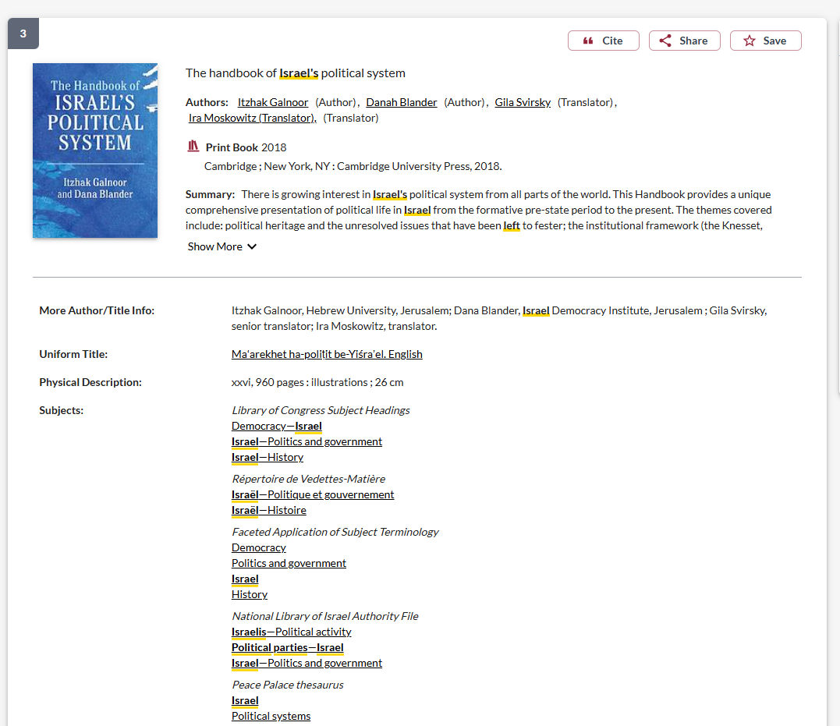
Use the subject headings to find books in these subject areas

Slide 32
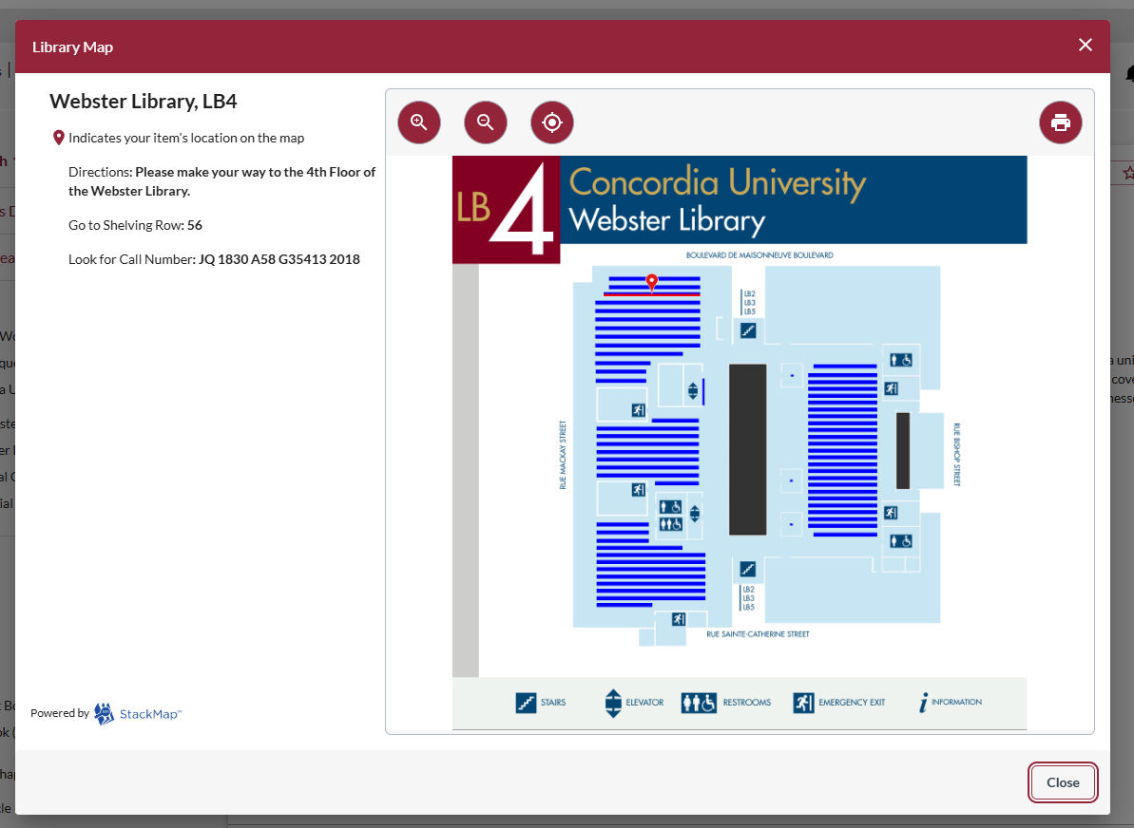
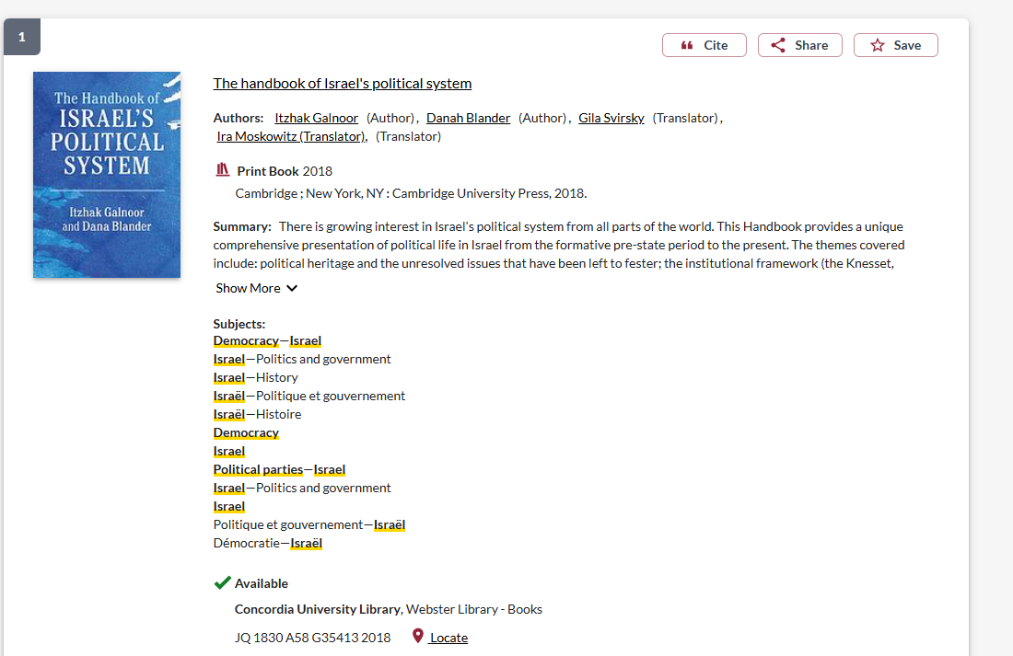

Slide 33
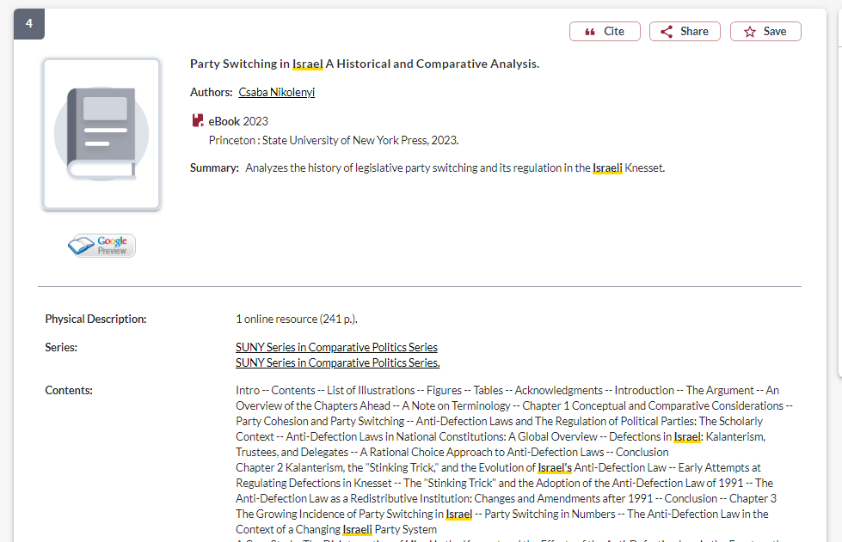
How do I know if a book is academic?
If the book is published by a university press, it is an academic book

Slide 34
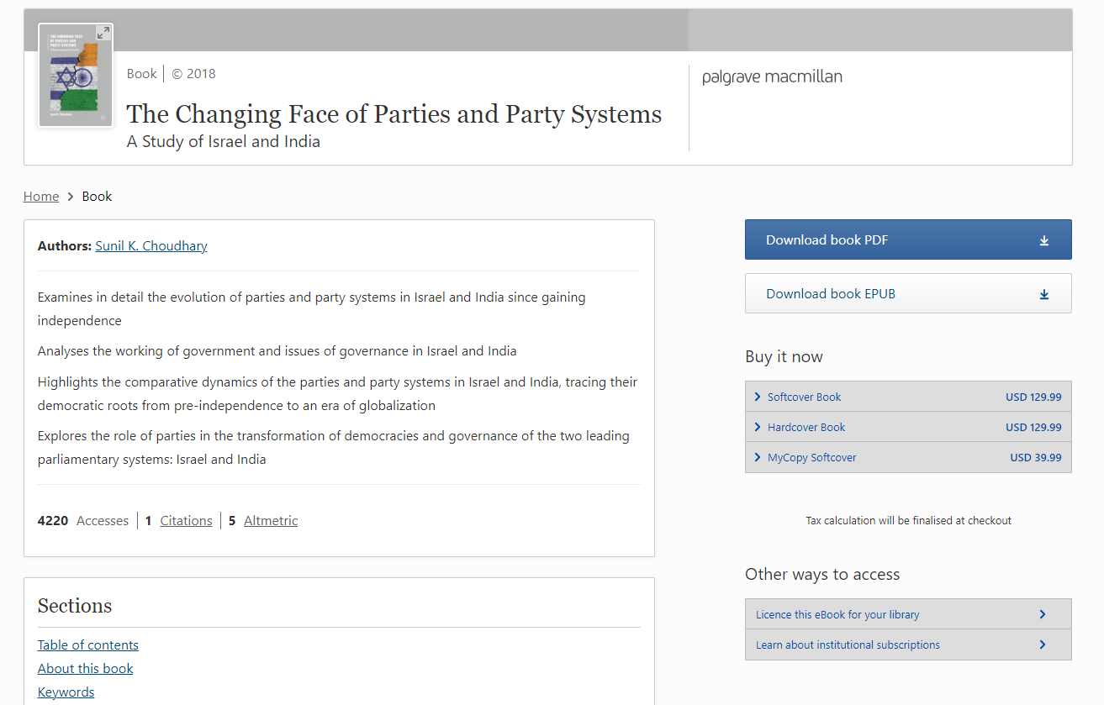
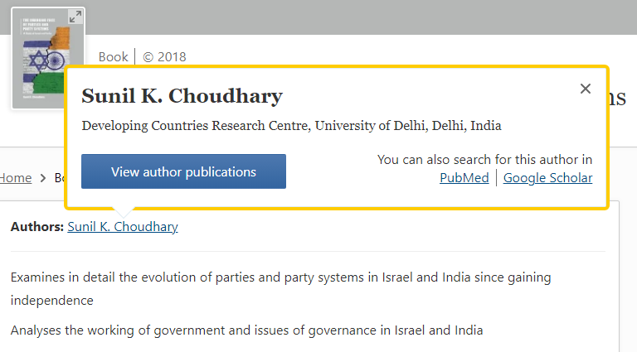
How do I know if a book is academic?
You should be able to locate the author/editor/contributor’s academic affiliations easily

Slide 35
Topic: The Abraham Accords led to an expansion in Israel’s formal diplomatic relations with Arab states in the Middle East. Compare and contrast the establishment of these formal ties with those that Israel had concluded with Egypt in 1979 and with Jordan in 1994!
Key Concept | Related terms/Synonyms
Abraham Accords | Arab-Israeli normalization, Israel and the Emirates, Israel and Bahrain, treaty of peace
Diplomatic relations | Diplomacy
Israel-Jordan peace treaty | Wadi Araba Treaty
Egypt- Israel peace treaty | Camp David Accords

Slide 36
Israel* AND (diplomacy OR diplomatic) AND (treaty OR accords) AND (abraham OR jordan OR egypt)

Slide 37
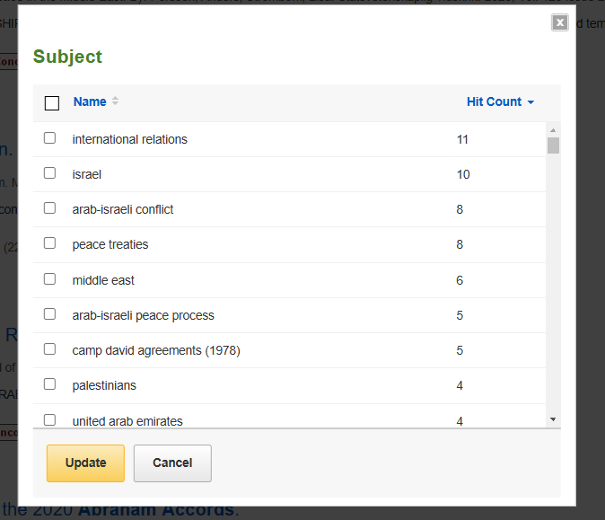
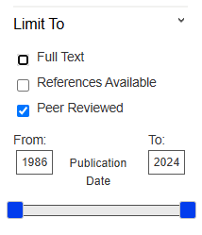
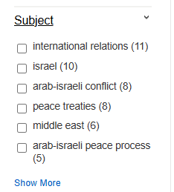
Political Science Complete: Articles

Slide 38
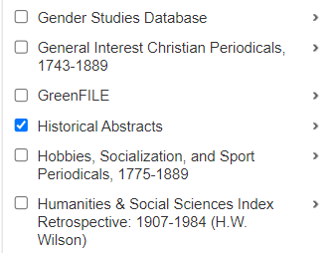
Search in 2 databases at once

Slide 39
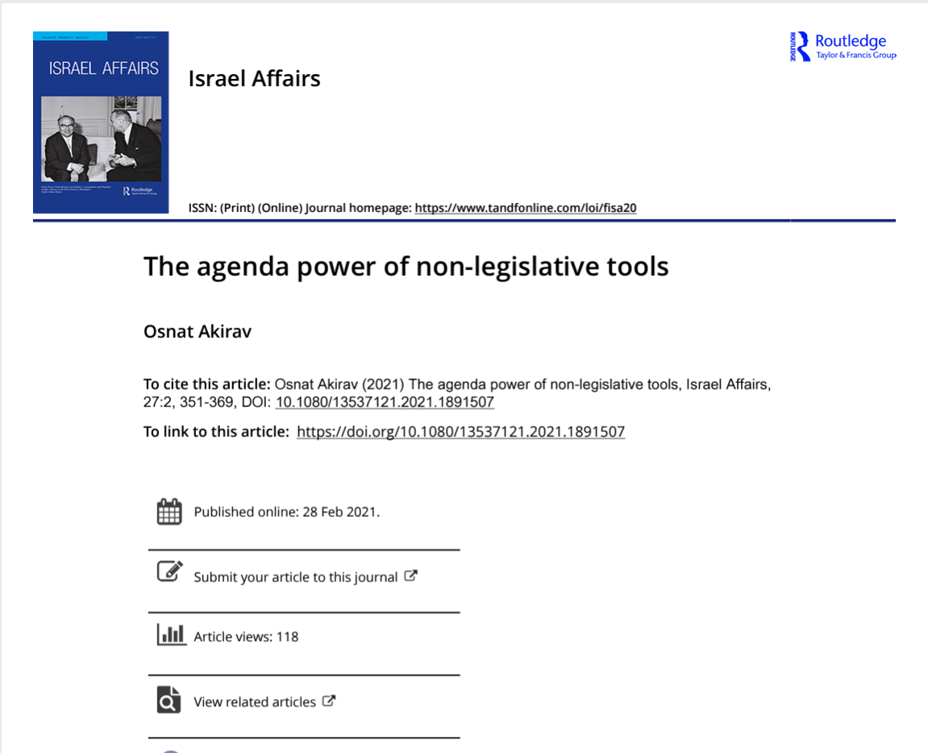
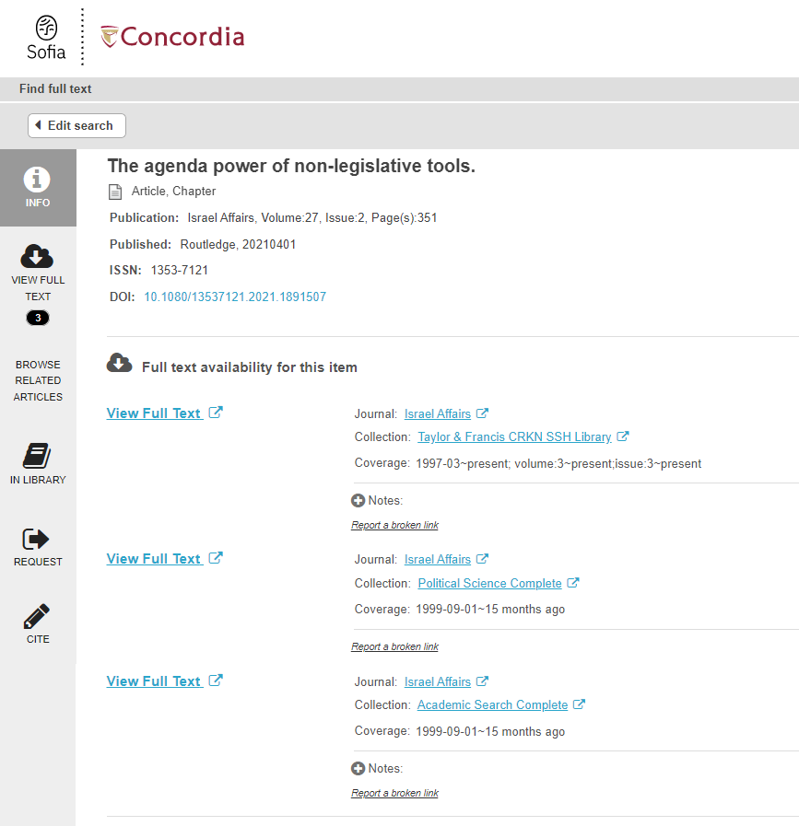
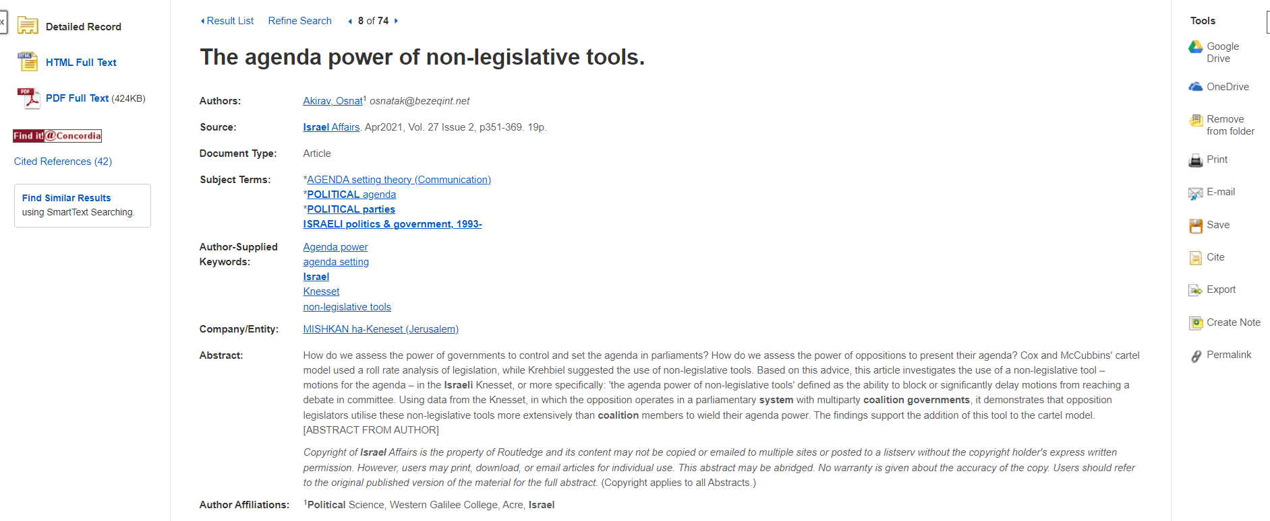
Use Find it @ Concordia if there is no PDF or HTML full text

Slide 40
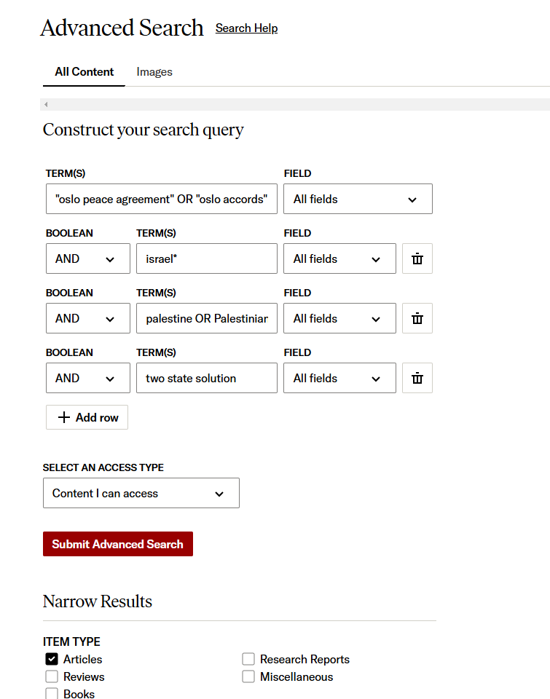
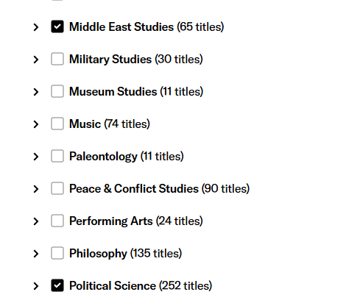
JSTOR: Articles
“Oslo peace agreement” OR “Oslo accords”
AND Israel*
AND Palestine OR Palestinian
AND two state solution
Narrow by discipline

Slide 41
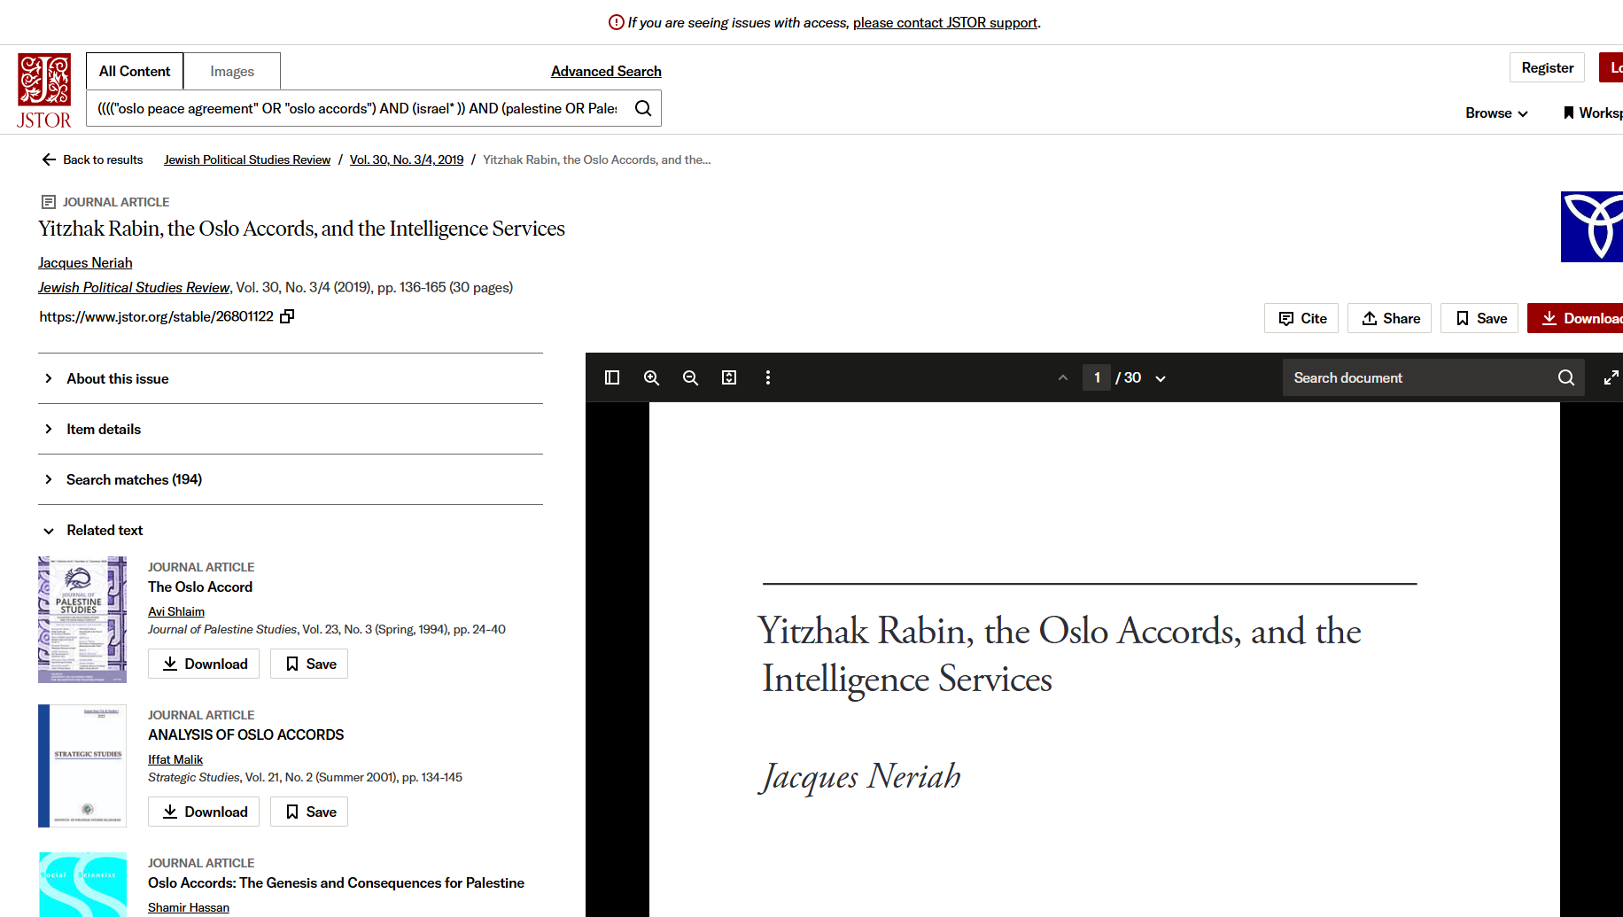
Check out the related texts, these articles will be on the same subject

Slide 42
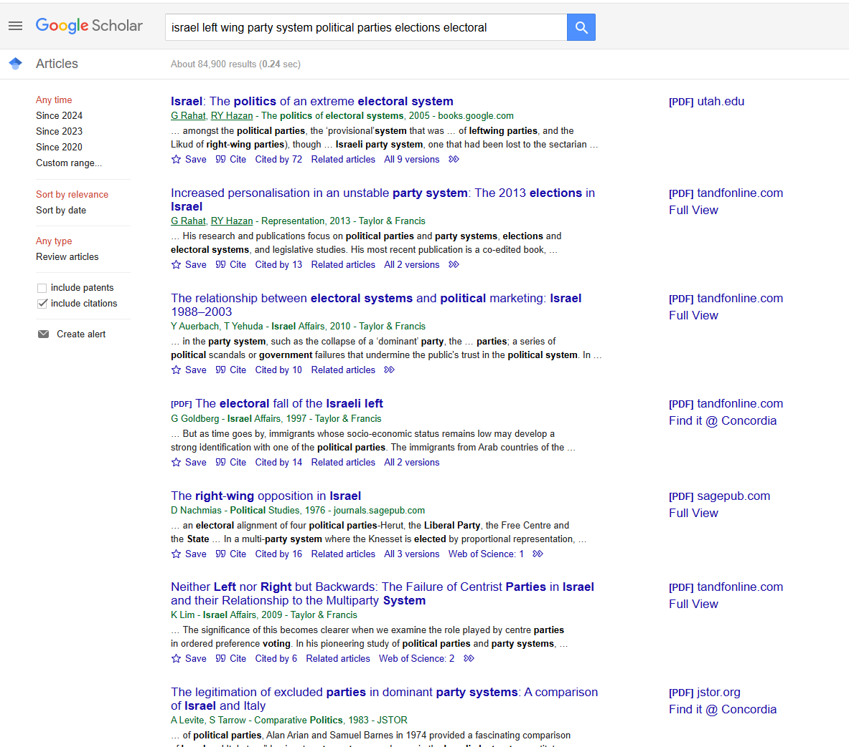
Google Scholar
You can narrow your search results by date, but you cannot narrow down to peer reviewed journal articles only in Google Scholar

Slide 43
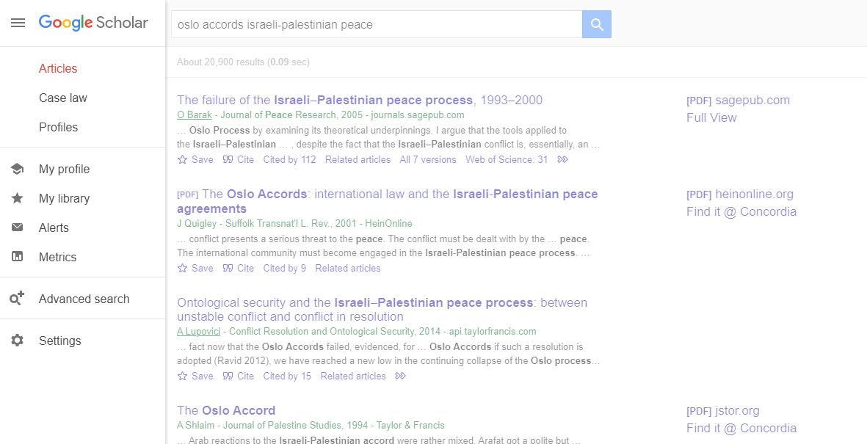
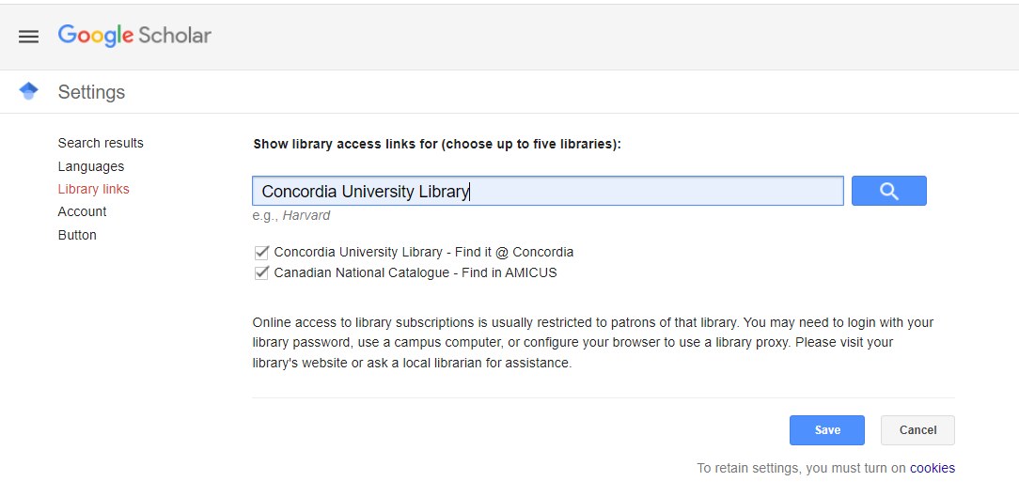

Slide 44
What is peer review? What are peer reviewed, scholarly articles?

Slide 45
Has the article gone through the peer review process? What is peer review? Peer review is a system used to decide if an article should be published in a peer-reviewed journal. Each paper submitted to a peer-reviewed journal is read and evaluated by experts in the article’s subject area. The reviewers assess the article’s validity, importance, and originality, and then recommend whether it should be printed in the journal. The reviewers’ suggestions are considered by the journal’s editor, who makes the final decision about whether to accept or reject the article. Criteria for evaluating academic or scholarly articles

Slide 46
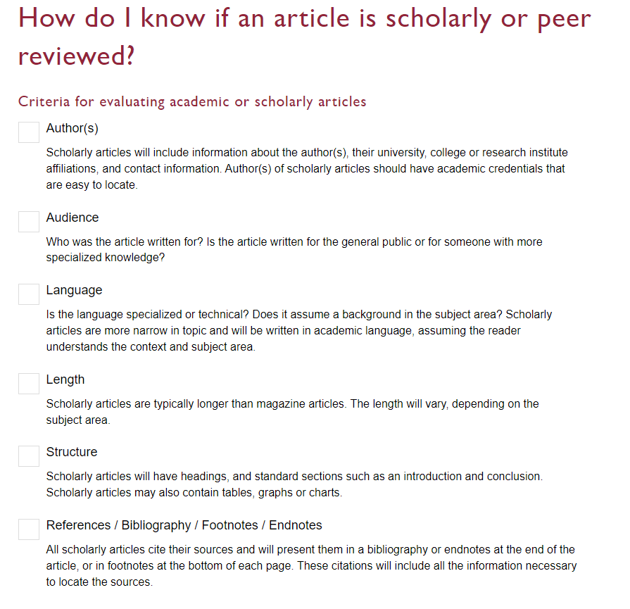

Slide 47
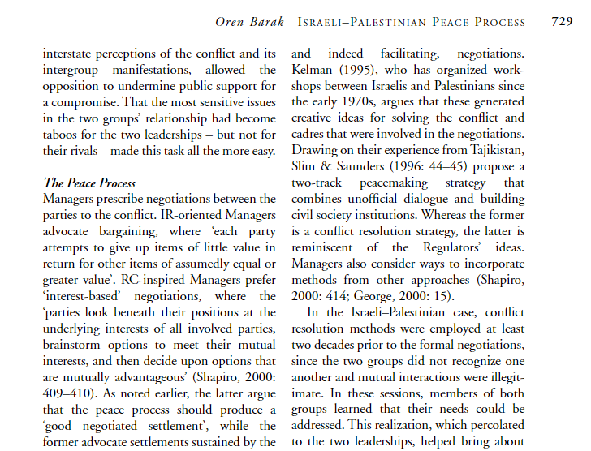
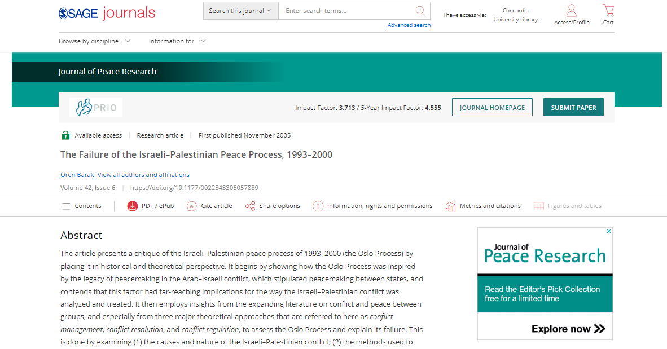
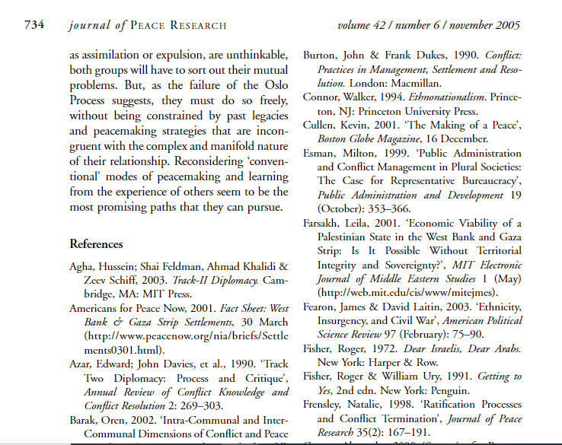
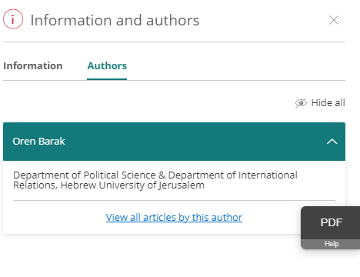
Citations throughout the article and an extensive reference list/bibliography/endnotes/footnotes is available at the end of the article.

Slide 48
Citing your sources

Slide 49
Citation Resources
Help and How to: How to Cite
Chicago (Author-Date) style guide

Slide 50
Wrap up
Political Science subject guide - POLI 322 Course guide provides quick access to key resources
The poli subject librarian (Michelle) is here to help
Your sources must collectively answer your research question
Evaluate everything you cite in your assignments
Properly cite all your sources!

Slide 51
Need help, ask us!
Michelle.Lake@Concordia.ca

